Slide 1
CityArchRiver
Kiener Plaza
Pre-Bid Meeting
November 17, 2016
Notes:
Ray facilitate

Slide 2
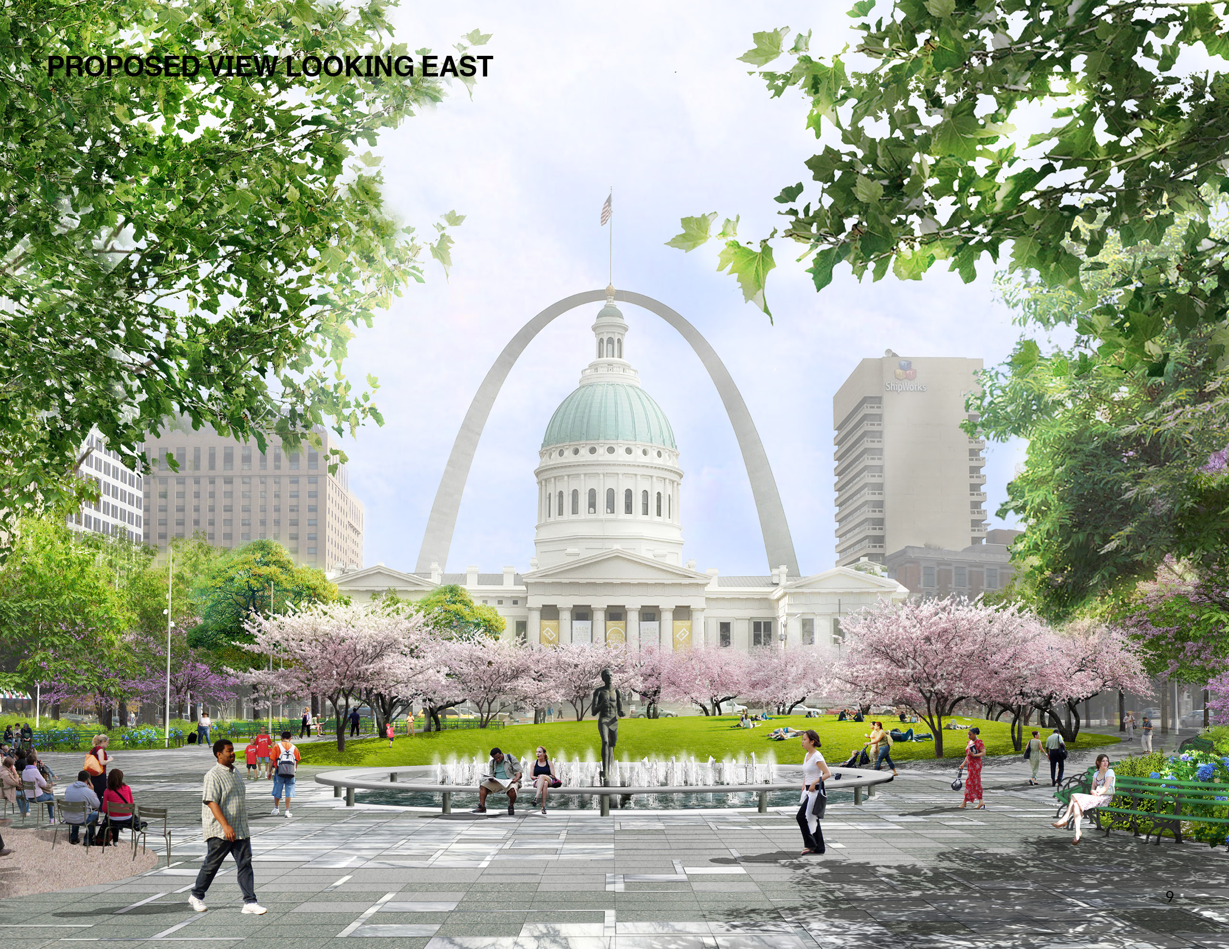
Purpose
  Familiarize bidders with the project, the site and the bid process.
Notes:
Ray –
Briefly review the purpose and agenda

Slide 3
Agenda
  Meeting Logistics
  Project Background
  Project Description
  Contracting Information
  Q&A
  Site Tour
Notes:
Ray –
Briefly review the agenda for the morning.

Slide 4
Project Representatives
Greg Hayes, City of St. Louis
Maggie Hales, CityArchRiver Foundation
Susan Trautman, Great Rivers Greenway
Notes:
Ray –
These are representatives here today from the NPS Denver Service Center
They will lead the tours and collect all questions on 3x5 cards

Slide 5



Public-Private Partnership
Notes:
Ray
Simply mention the public-private partnership and introduce Susan

Slide 6
Project Background
  Maggie Hales, President

Slide 7
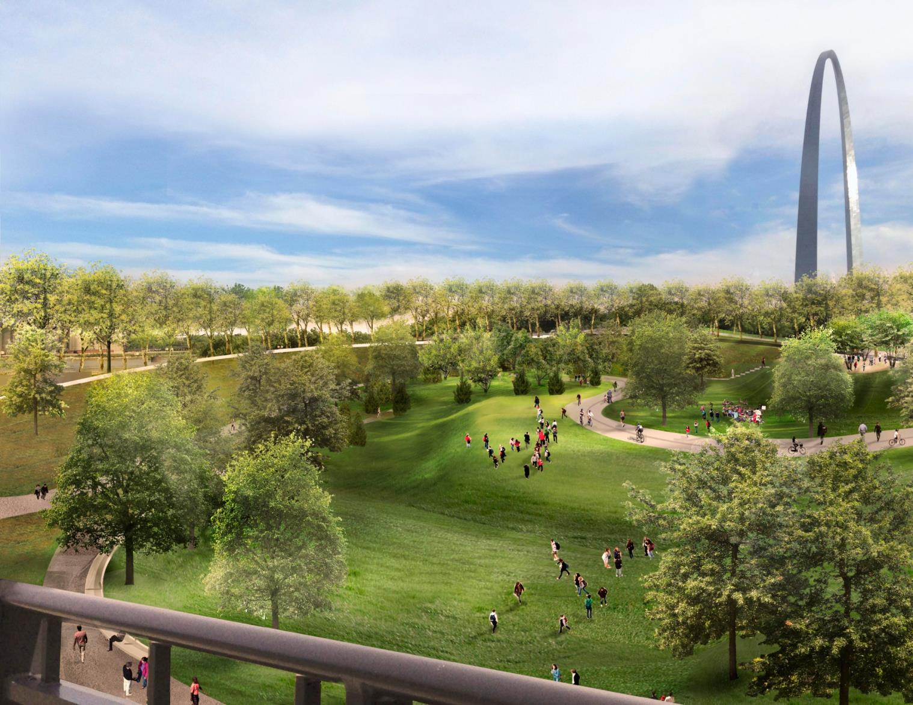
CityArchRiver
Partnership:
  CityArchRiver Foundation
  Great Rivers Greenway District
  City of St. Louis
  National Park Service
  MoDOT
  BiState Development Agency

Slide 8

CityArchRiver
Goals:
  Revitalize the Arch Grounds
  Reconnect the City to the Arch and the River
  Improve Visitor Experience
  Safe Access from the City to the Arch and the River
  Economic Revitalization of the Park, the District and the City
  Boost Jobs and Economic Development in the St. Louis Region

Slide 9
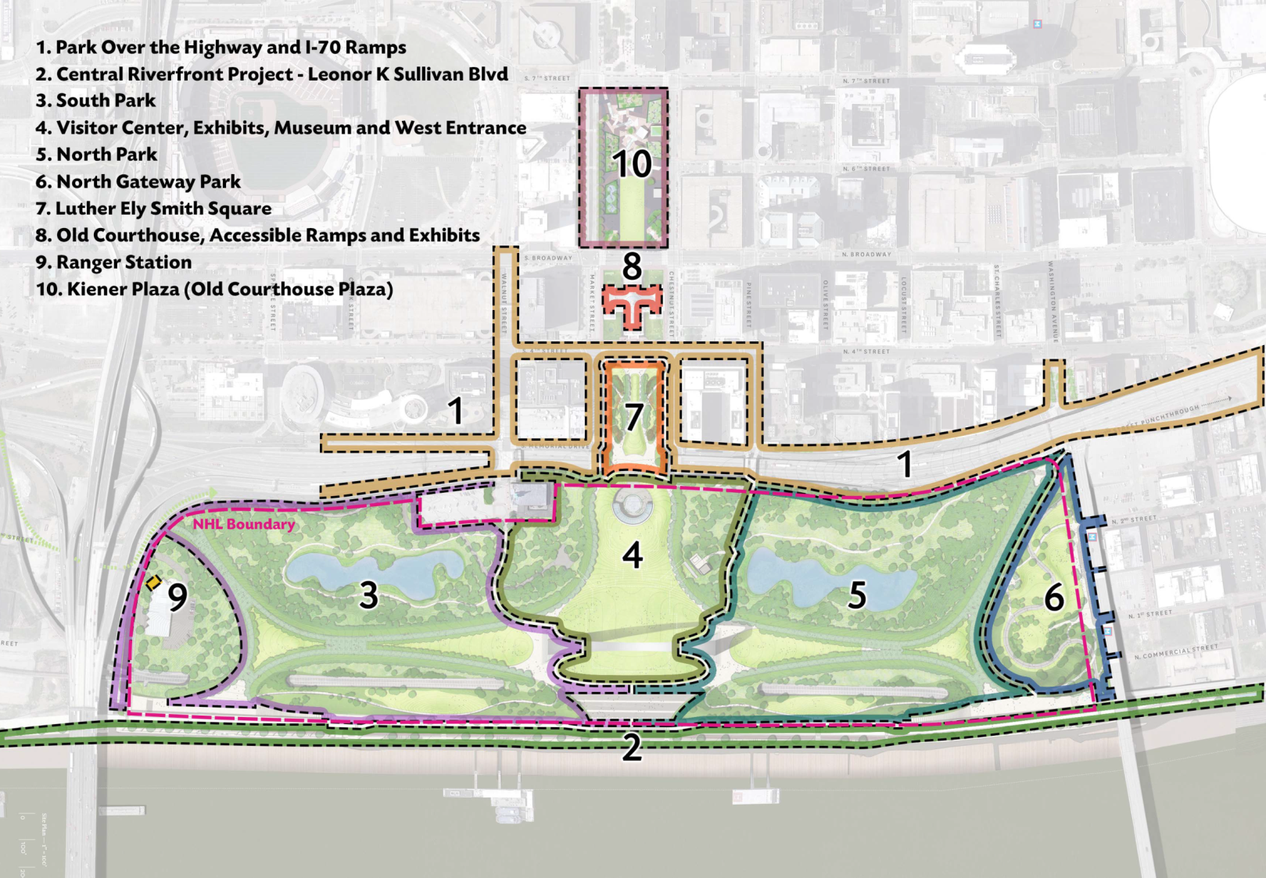

Slide 10
CityArchRiver Foundation
Kiener Plaza
Project Design
  Michael Van Valkenburgh Associates
Partial Construction Funding
Construction Administration Services

Slide 11
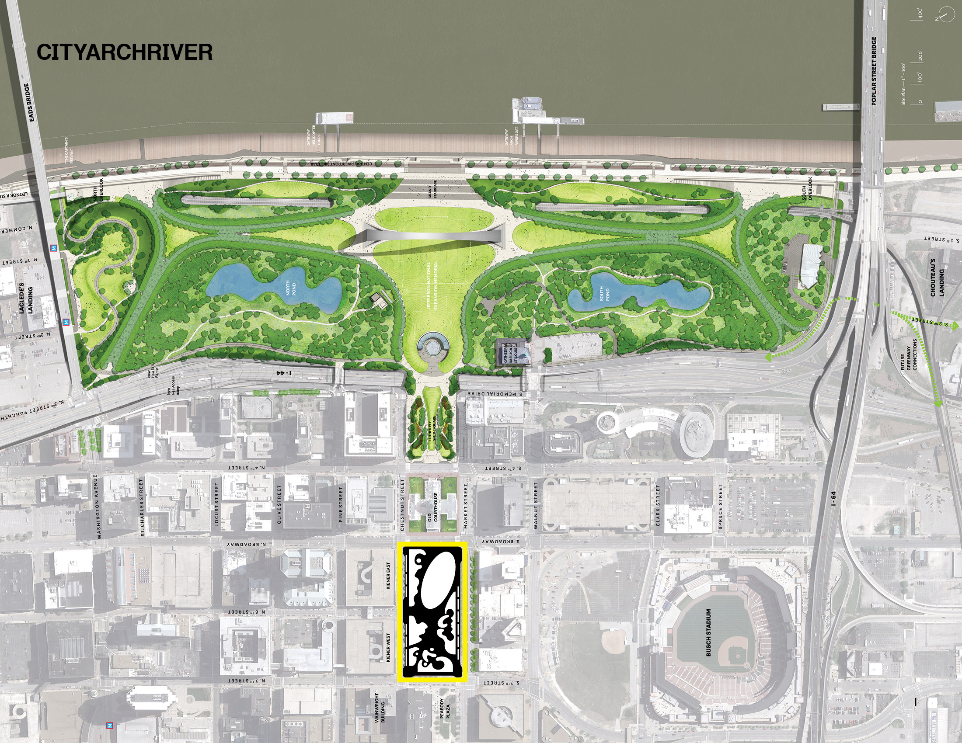
CityArchRiver 2015 Project & Kiener Plaza

Slide 12
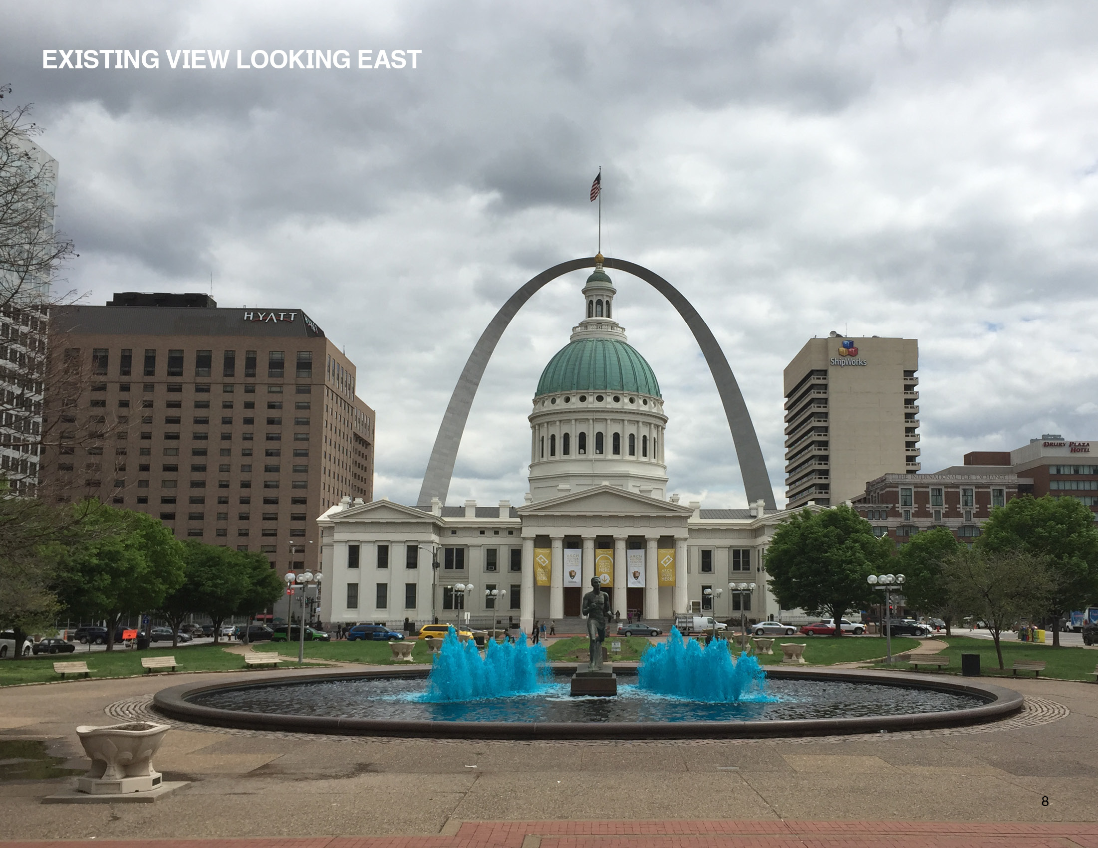
East Slope Paths
Pre-Bid Conference

Slide 13
East Slope Paths
Pre-Bid Conference

Slide 14
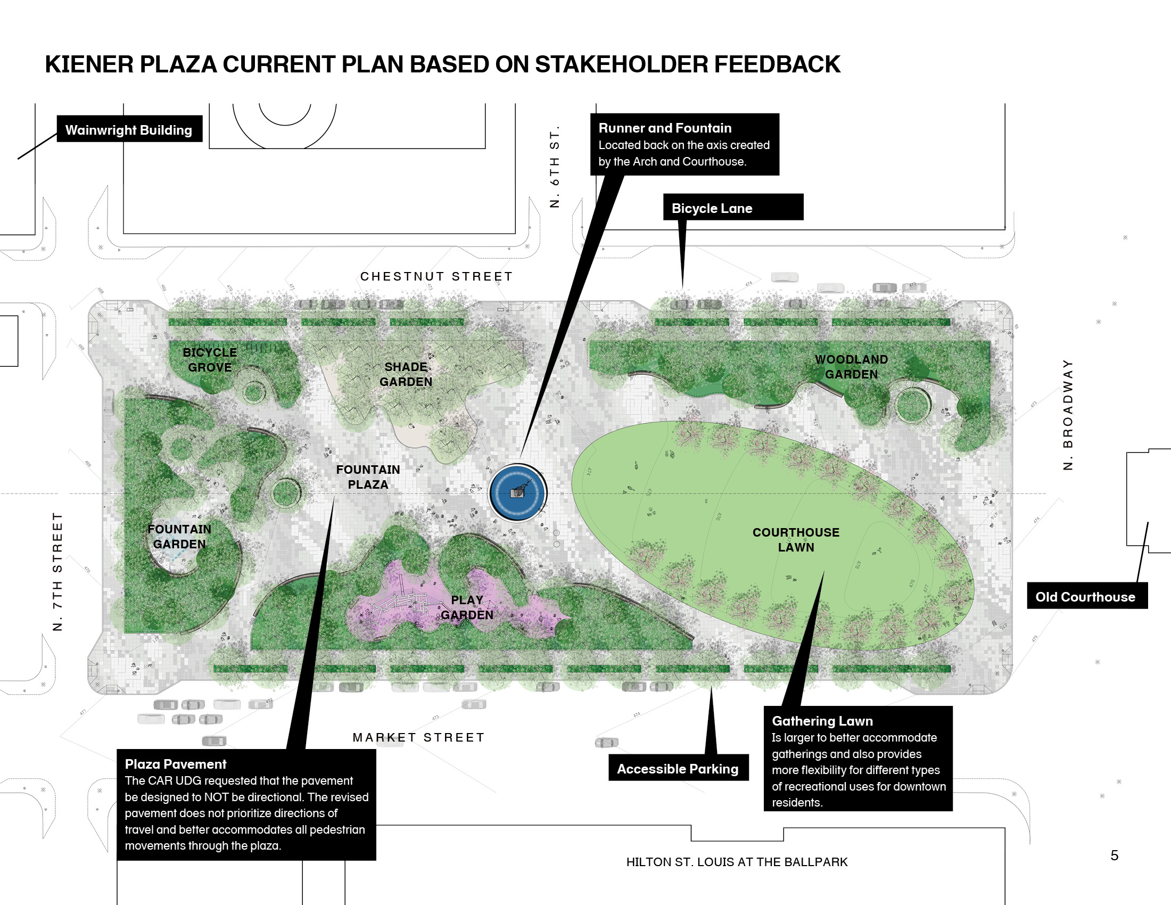
Reflecting Ponds
Pre-Bid Conference

Slide 15
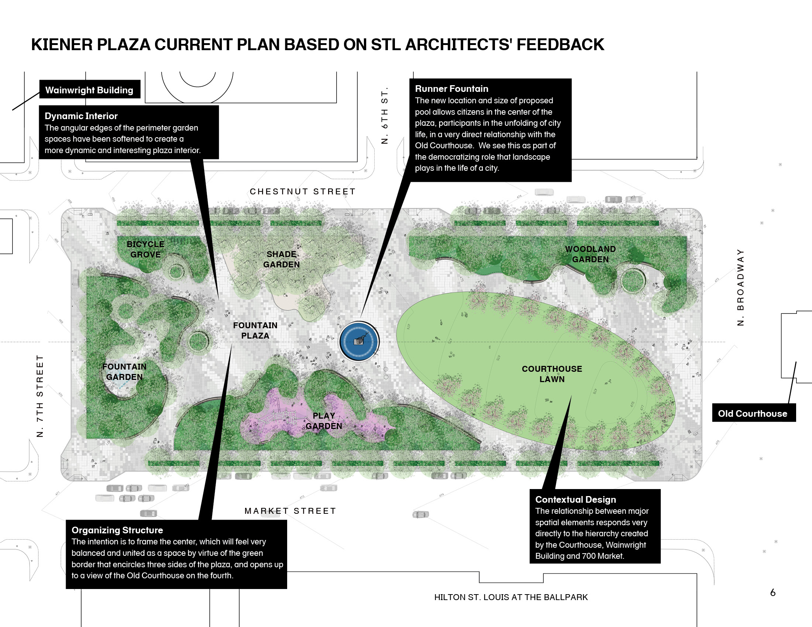
Reflecting Ponds
Pre-Bid Conference

Slide 16
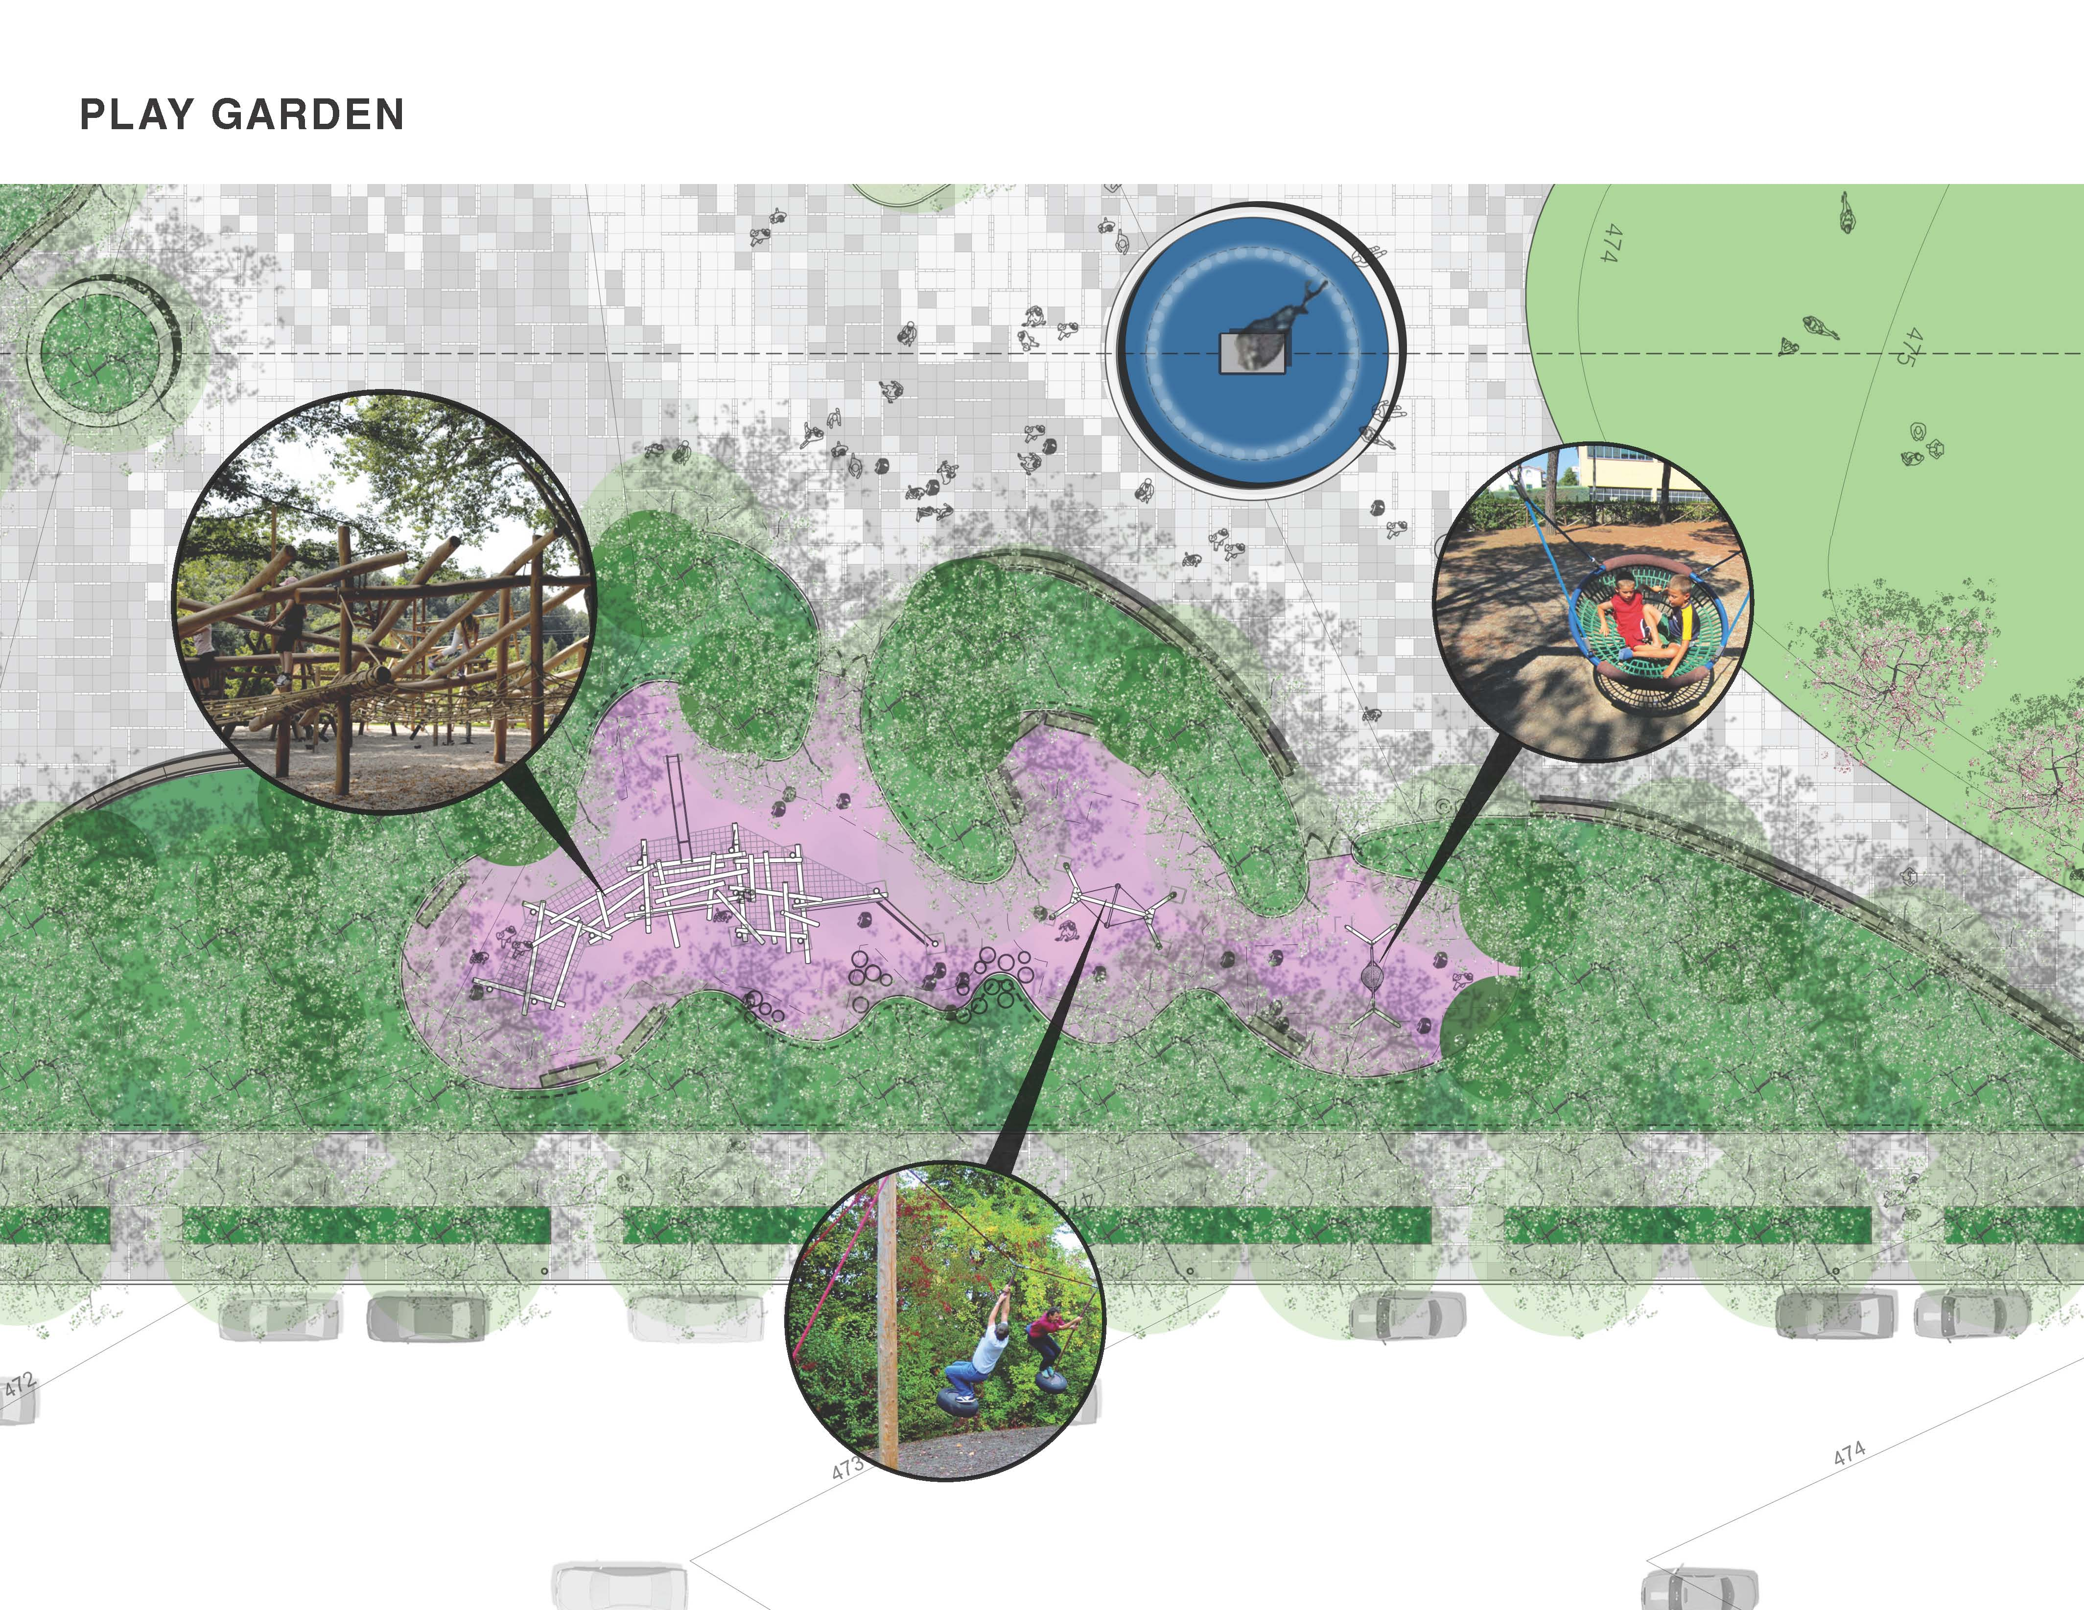

Slide 17
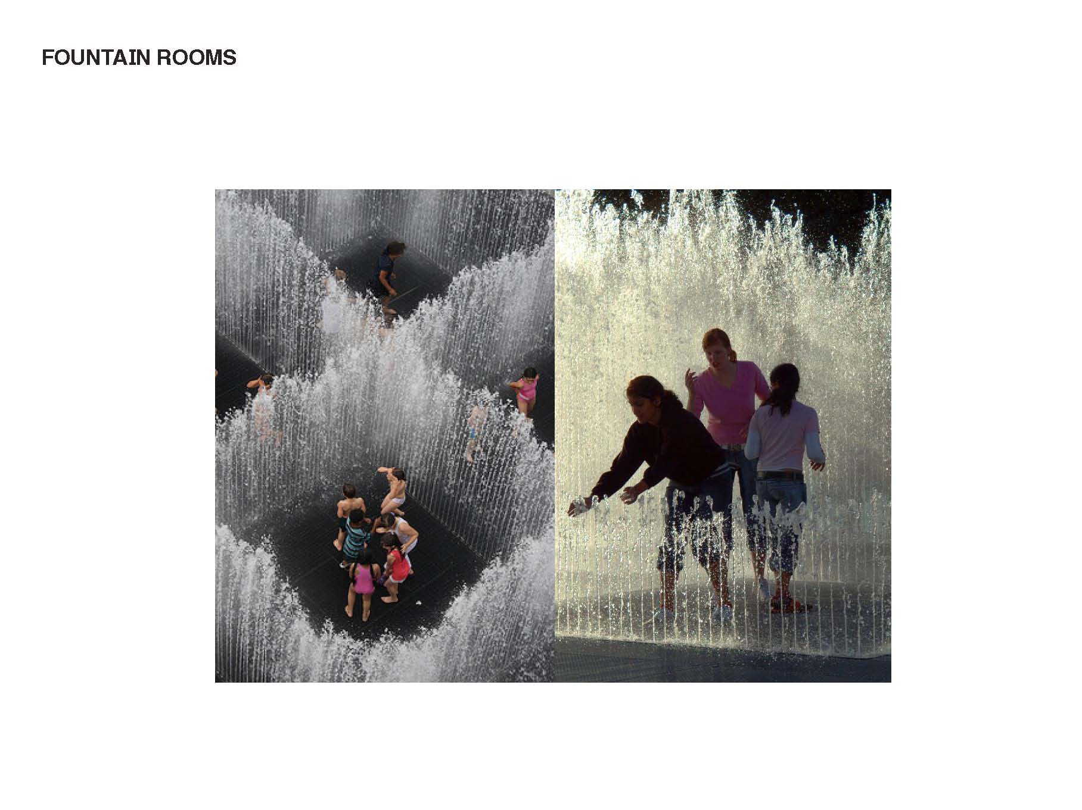

Slide 18
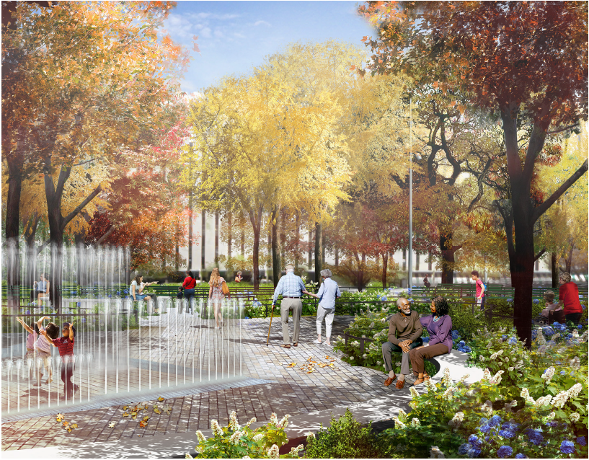
FOUNTAIN GARDEN

Slide 19
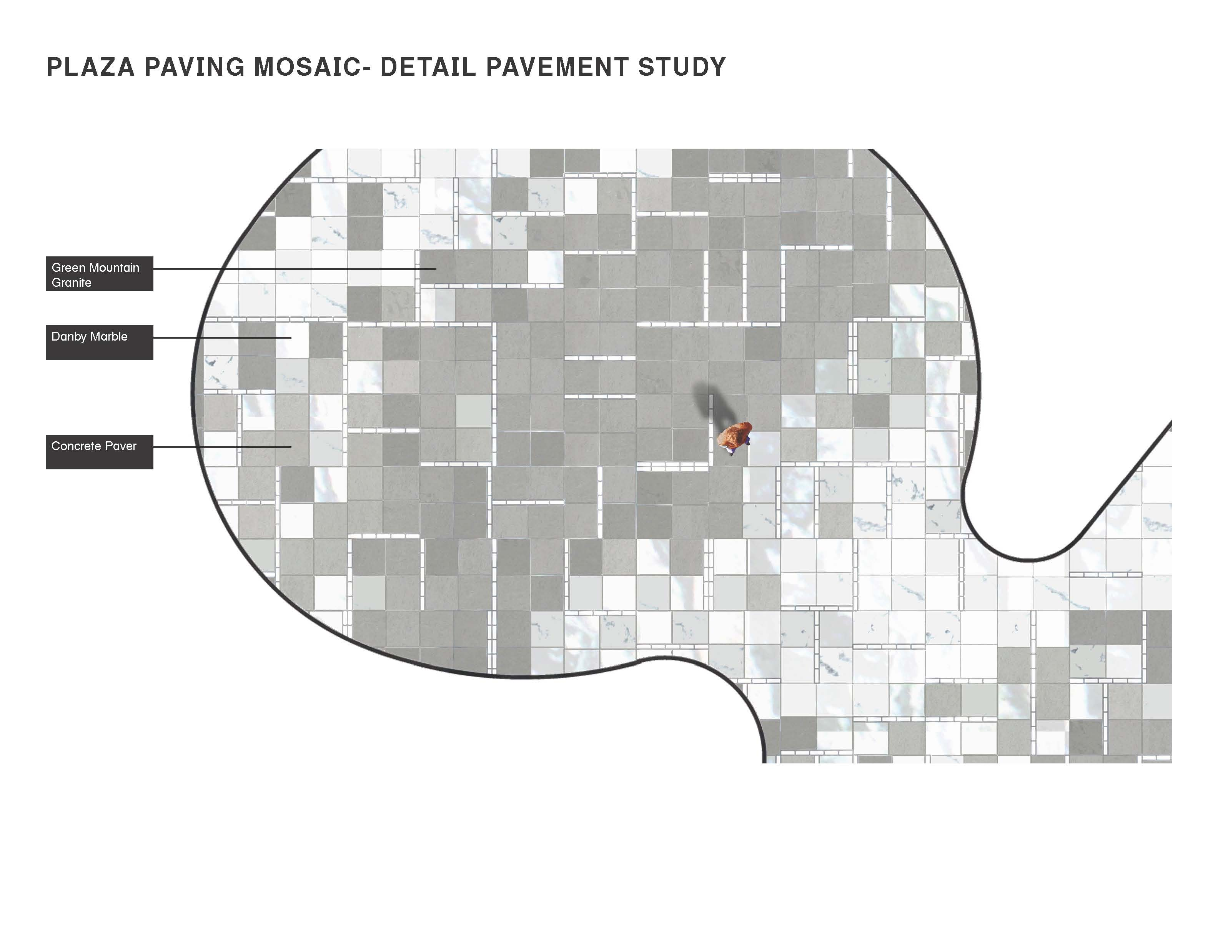
Reflecting Ponds
Pre-Bid Conference

Slide 20
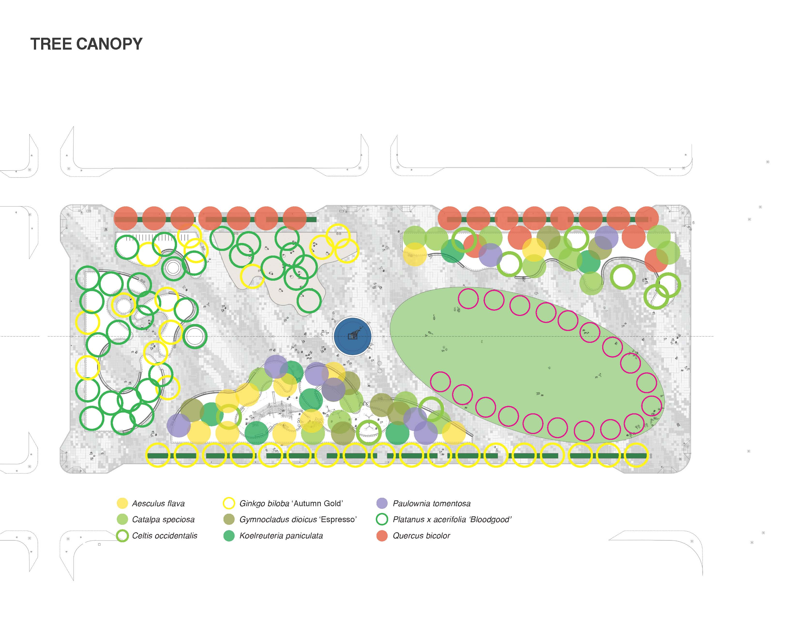
Reflecting Ponds
Pre-Bid Conference

Slide 21
  Susan Trautman, Executive Director
Notes:
Danny

Slide 22
Great Rivers Greenway District
Kiener Plaza
Partial Construction Funding
Contract Award
Construction Management
  BSI Constructors (Joe Kaiser)
Materials Testing & Inspection
Inclusion tracking & reporting

Slide 23
Ten Construction Work Categories
  #2 Earthwork/Demolition
  #3 Site Sewers
  #4 Plumbing/Site Water/Fountains
  #5 Concrete
  #6 Electrical
  #7 Pavers/Stone
  #8 Metals/Railings
  #9 Landscaping/Irrigation
  #10 Carpentry/Miscellaneous
  #11 Site Furnishings (previously part of work category #10)
Notes:
Danny,
Introduce the fact that this is the first of seven (or more) concurrent projects.
* Why projects are broken up the way they are…
Other work
Maintain Park Operations
Visitor enjoyment/safety
Access
Pay attention to coordination requirements outlined in the specification
Next several slides show how the projects are related

Slide 24
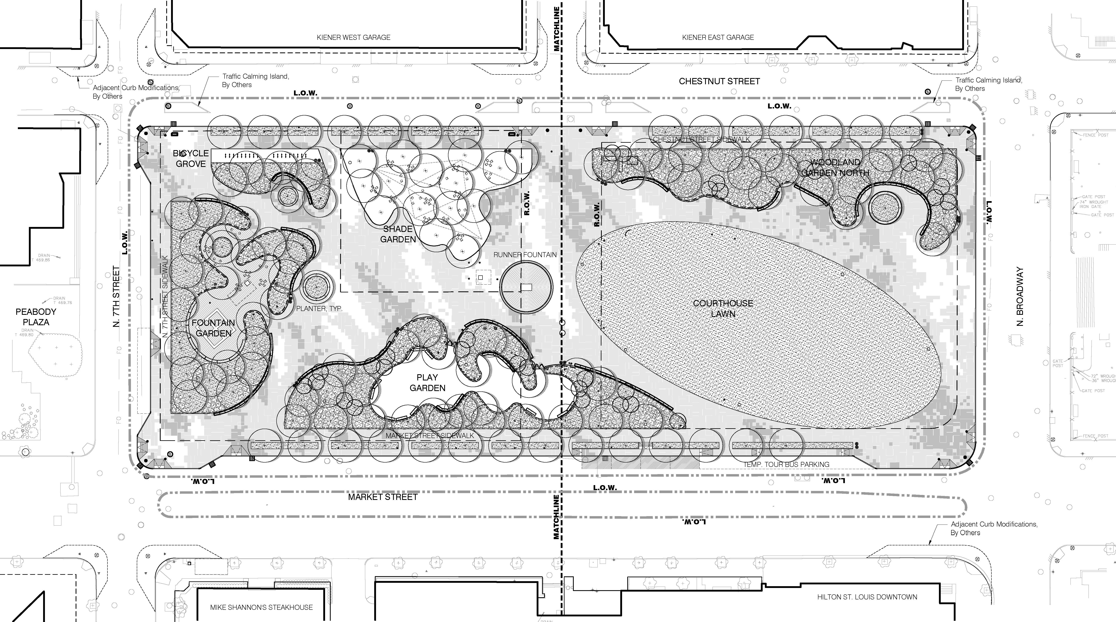
Signalization & Street Improvement Phase
CMAQ Federal Grant

Slide 25
Signalization & Street Improvement Phase
CMAQ Work Categories:
  Traffic Lights and Pedestrian Signalization
  Pedestrian Curb Ramps
  Street asphalt milling and overlay
Timeframe:
  Out to bid: Summer/Fall 2016
  Construction: Winter 2016/Spring 2017

Slide 26
Kiener Plaza Diversity Inclusion
    Firms are encouraged to team or form joint ventures
    Mayor’s Executive Order 28/47
        25 percent minority business enterprise (MBE) participation goal for contracts
        5 percent women’s business enterprise (WBE) participation goal for contracts
    Workforce
        14.7 percent minority workforce participation goal
        6.9 percent female participation goal
Notes:
Just a brief overview of the scope of work

Slide 27
Anticipated Construction Schedule
    Bids Due, December 10 at 2:00 PM
        Great Rivers Greenway Office 6178 Delmar Blvd.
        Publically opened and read aloud
    Contract Awards
        January 5, 2016
    14 month construction duration
Notes:
Just a brief overview of the scope of work

Slide 28
General Contract Information
  Lump Sum, Total Base Bid in each Work Category
  Firm Fixed-Price
  Labor
    Mayor’s Executive Order 28/47
    Contract goals of 25% MBE and 5% WBE
    Workforce goals of 14.7% minority and 6.9% female
    Equal Employment Opportunity Requirement
Notes:
Ray,
EEO = 14.7% Minority
6.9% Women

Slide 29
General Contract Information
  Contract Documents at Cross Rhodes Reprographics
    Planholder list at http://www.x-rhodesplanroom.com/public.php
  Bid Bond of 5% of total base bid
  Show MBE/WBE subcontractor/supplier participation on GRG Form 2, to be submitted with bid
  Performance & Payment Bond of 100% of awarded contract
  Time of Performance 425 calendar days (14 months)
  Liquidated Damages of $400 per calendar day
Notes:
Ray,
EEO = 14.7% Minority
6.9% Women

Slide 30
Bids Due
  Thursday, December 10 at 2:00 PM CST
  Great Rivers Greenway Office
    6178 Delmar Blvd.
  Firms are encouraged to team or form joint ventures
Notes:
Ray,
EEO = 14.7% Minority
6.9% Women

Slide 31
Questions During Proposal Period
  Submit via email to: lboring@grgstl.org
  Deadline for questions is December 3
Notes:
Lori

Slide 32
Questions?

Slide 33
Site Tour

