Slide 1
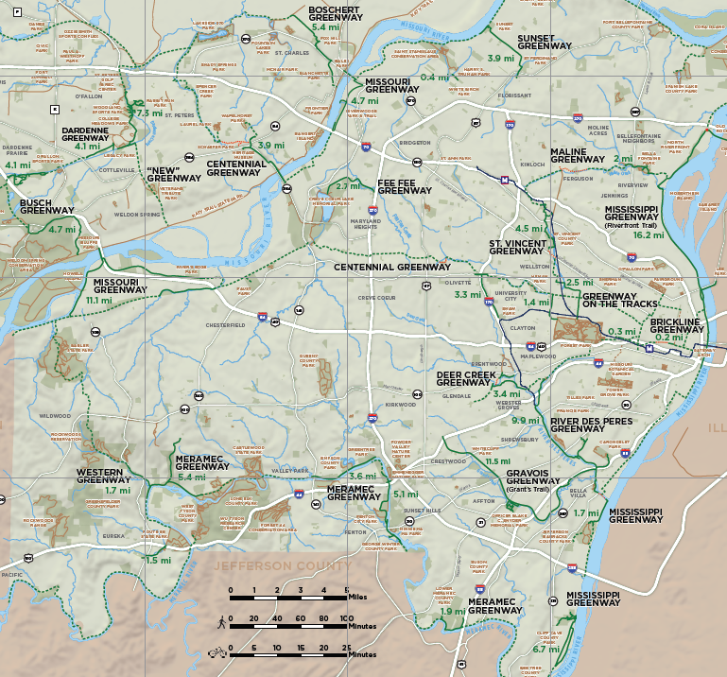


Great Rivers Greenway – Completion Tracker
# | Path | Total Miles | Date Completed | Notes
1 | BOSCHERT GREENWAY New Town to Historic St. Charles to Katy Trl | 5.44
2 | BRICKLINE GREENWAY Boyle to Sarah Ave | 0.27
3 | BRICKLINE GREENWAY Market St: 20th to 22nd | 0.23
4 | BUSCH GREENWAY Katy Trail to MO Res. Pk to Busch Cons. Area | 4.72
5 | CENTENNIAL GREENWAY Forest Park to Wash U to Vernon | 1.35
6 | CENTENNIAL GREENWAY Page Ext to Katy Trl to Heritage Museum | 3.88
7 | CENTENNIAL GREENWAY Shaw Park to Olive Blvd | 2.48
8 | DARDENNE GREENWAY Cottleville Trail to Legacy Park/Vantage Park | 4.13
9 | DARDENNE GREENWAY Legacy Park to Dardenne Park | 7.32
10 | DARDENNE GREENWAY Barathaven | 4.13
11 | DEER CREEK GREENWAY Deer Creek Park to Lorraine Davis Park | 3.35
12 | FEE FEE GREENWAY Aquaport to Creve Coeur Park | 2.74
13 | GRAVOIS GREENWAY: Grant’s Trail River des Peres to Holmes & Leffingwell | 11.47
14 | MALINE GREENWAY Bella Fontaine County Park | 1.97
15 | MERAMEC GREENWAY George Winter Park to Unger Park | 5.12
16 | MERAMEC GREENWAY Glencoe to Sherman Beach Park | 5.41
17 | MERAMEC GREENWAY Greentree Park to Arnold’s Grove Park | 3.62
18 | MERAMEC GREENWAY Lions Park to Route 66 State Park | 1.5
19 | MERAMEC GREENWAY Lower Meramec Park | 1.92
20 | MISSISSIPPI GREENWAY: Riverfront Trail Chouteau Ave to Old Chain of Rocks | 16.19
21 | MISSISSIPPI GREENWAY Cliff Cave County Park | 6.69
22 | MISSISSIPPI GREENWAY Jefferson Barracks Park to River City Casino | 1.74
23 | MISSOURI GREENWAY Earth City Levee & 370 Connection | 4.7
24 | MISSOURI GREENWAY Monarch Chesterfield Levee & 64/40 | 11.09
25 | MISSOURI GREENWAY Truman Park | 0.36
26 | RIVER DES PERES GREENWAY Francis Slay Park to Metrolink/Car./Lemay | 9.9
27 | ST. VINCENT GREENWAY Forest Park to Robert Powell Place | 2.49
28 | ST. VINCENT GREENWAY St. Charles Rock Rd to N Hanley Metro | 4.46
29 | SUNSET GREENWAY Old Town Florissant to Sunset Park | 3.9
30 | WESTERN GREENWAY Rockwoods Reservation to Meramec Greenway | 1.72
Click here for the full GRG Online Map!
1
29
25
23
9
8
14
10
6
12
4
28
20
24
7
5
27
2
3
20
11
17
26
30
16
13
15
22
18
Click on Map # for Trail Link!
19
21

