Slide 1
DAY / MONTH / YEAR

Slide 2

Community Presentation Basics
Use this Powerpoint Presentation to help increase awareness of bicycling in your community.
The Presentation includes information about:
  The Gateway Bike Plan
  The Benefits of Bicycling
  Basic Bicycle Facility Types
These slides are intended to be tailored specifically to your project or audience, so please add new slides or subtract unneeded slides.
For additional assistance or information, please contact Elizabeth Simons, Community Program Manager at Great Rivers Greenway, at esimons@grgstl.org

Slide 3
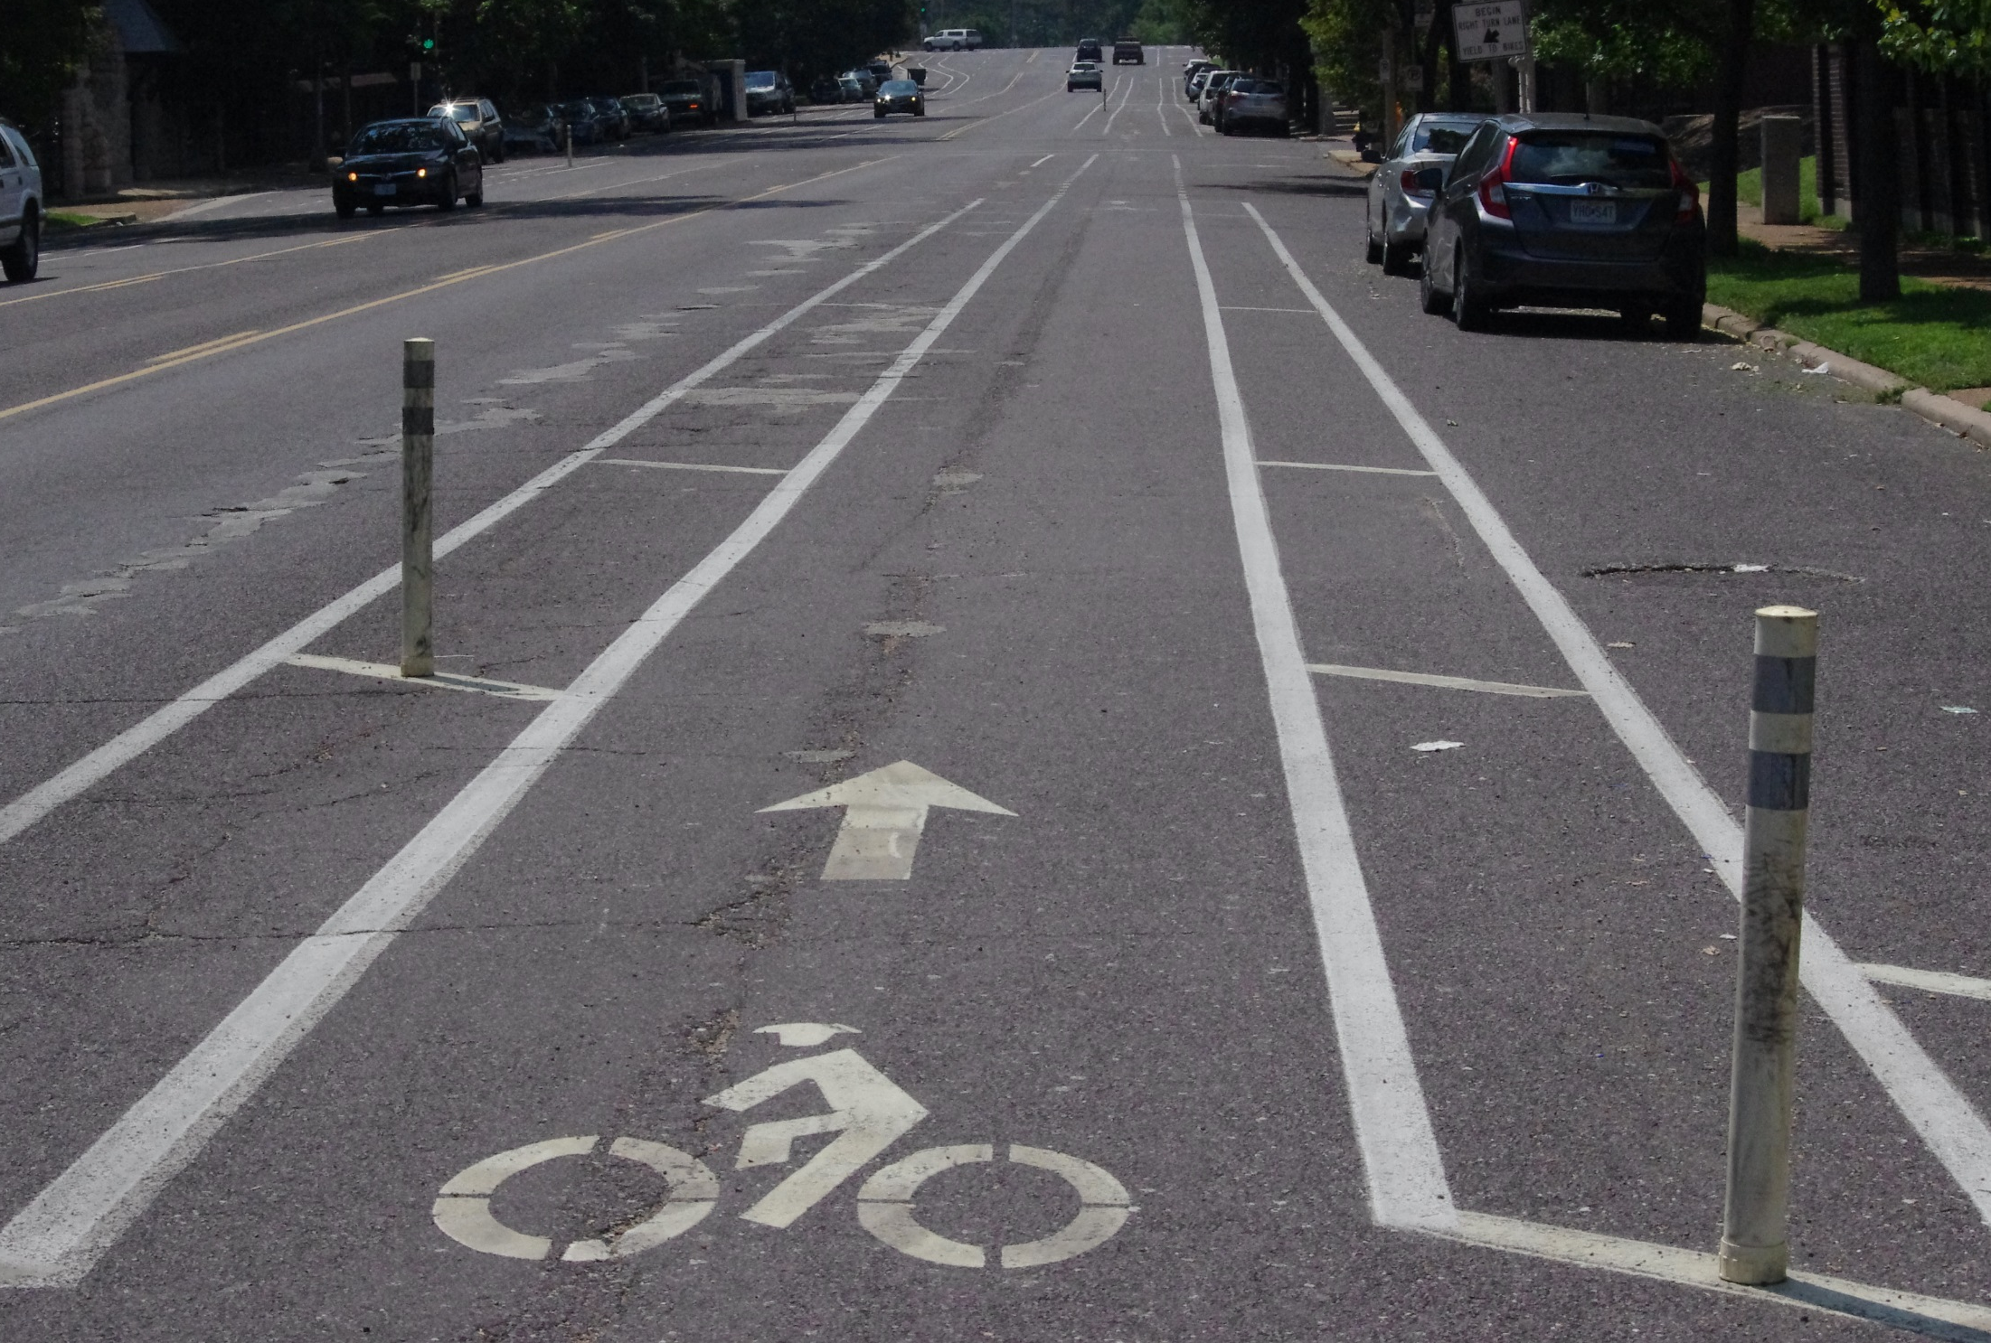
What is the Gateway Bike Plan?
The Gateway Bike Plan is the blueprint for building a regional on-street network of bikeways in St. Louis City, St. Louis County, and St. Charles County, with connections to area trails and greenways.
The Plan was completed in 2011 and is being implemented by communities across the region.

Slide 4
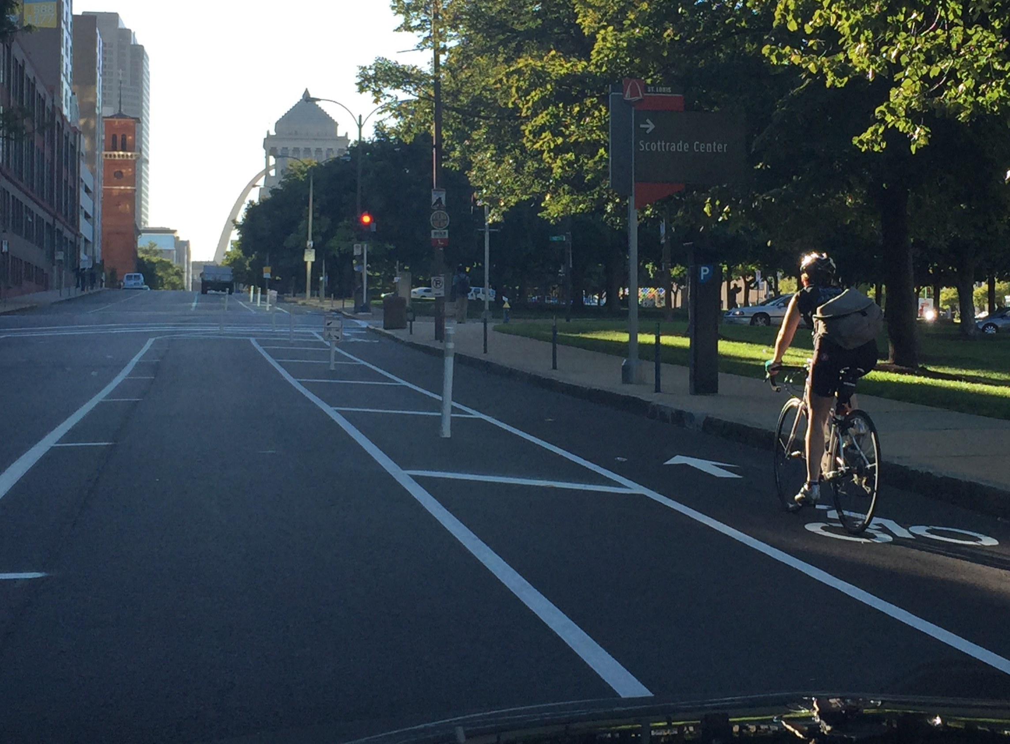
The Vision & Mission
VISION: The Gateway Bike Plan will create the bicycle component to the regional transportation network that accommodates all users and promotes consistent design and development of bicycle facilities.
MISSION: Increase the number of people using bicycles for transportation while reducing the number of crashes involving bicycles.

Slide 5
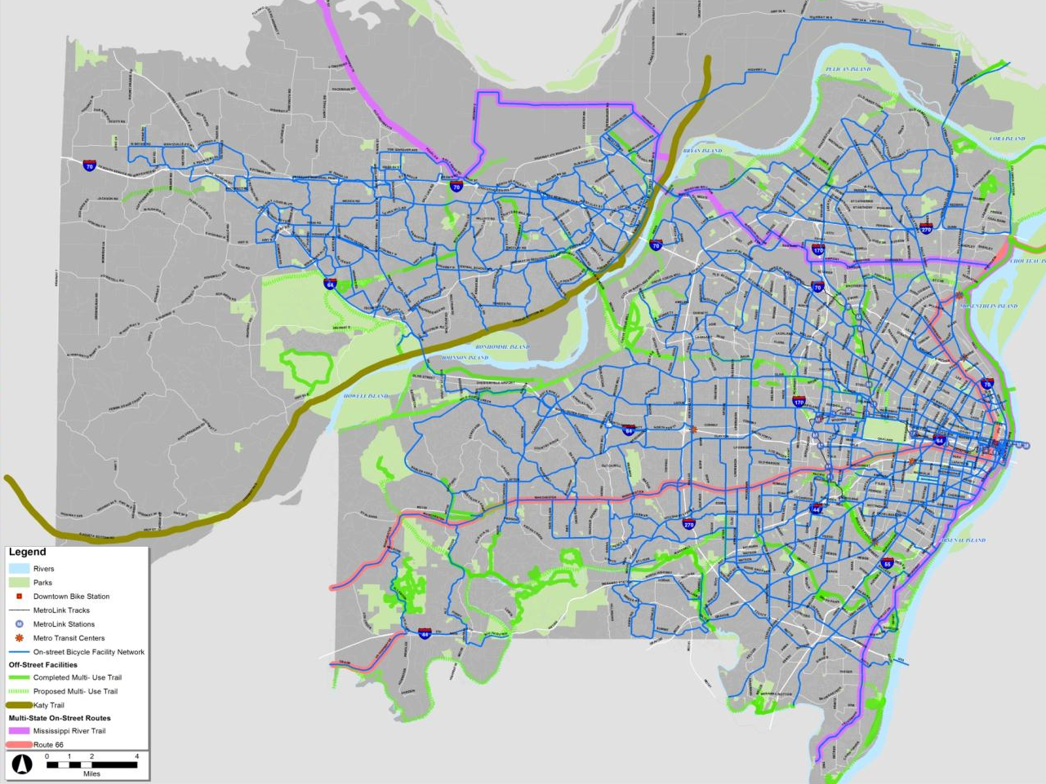
Recommended Bike Network (1019 miles)

Slide 6
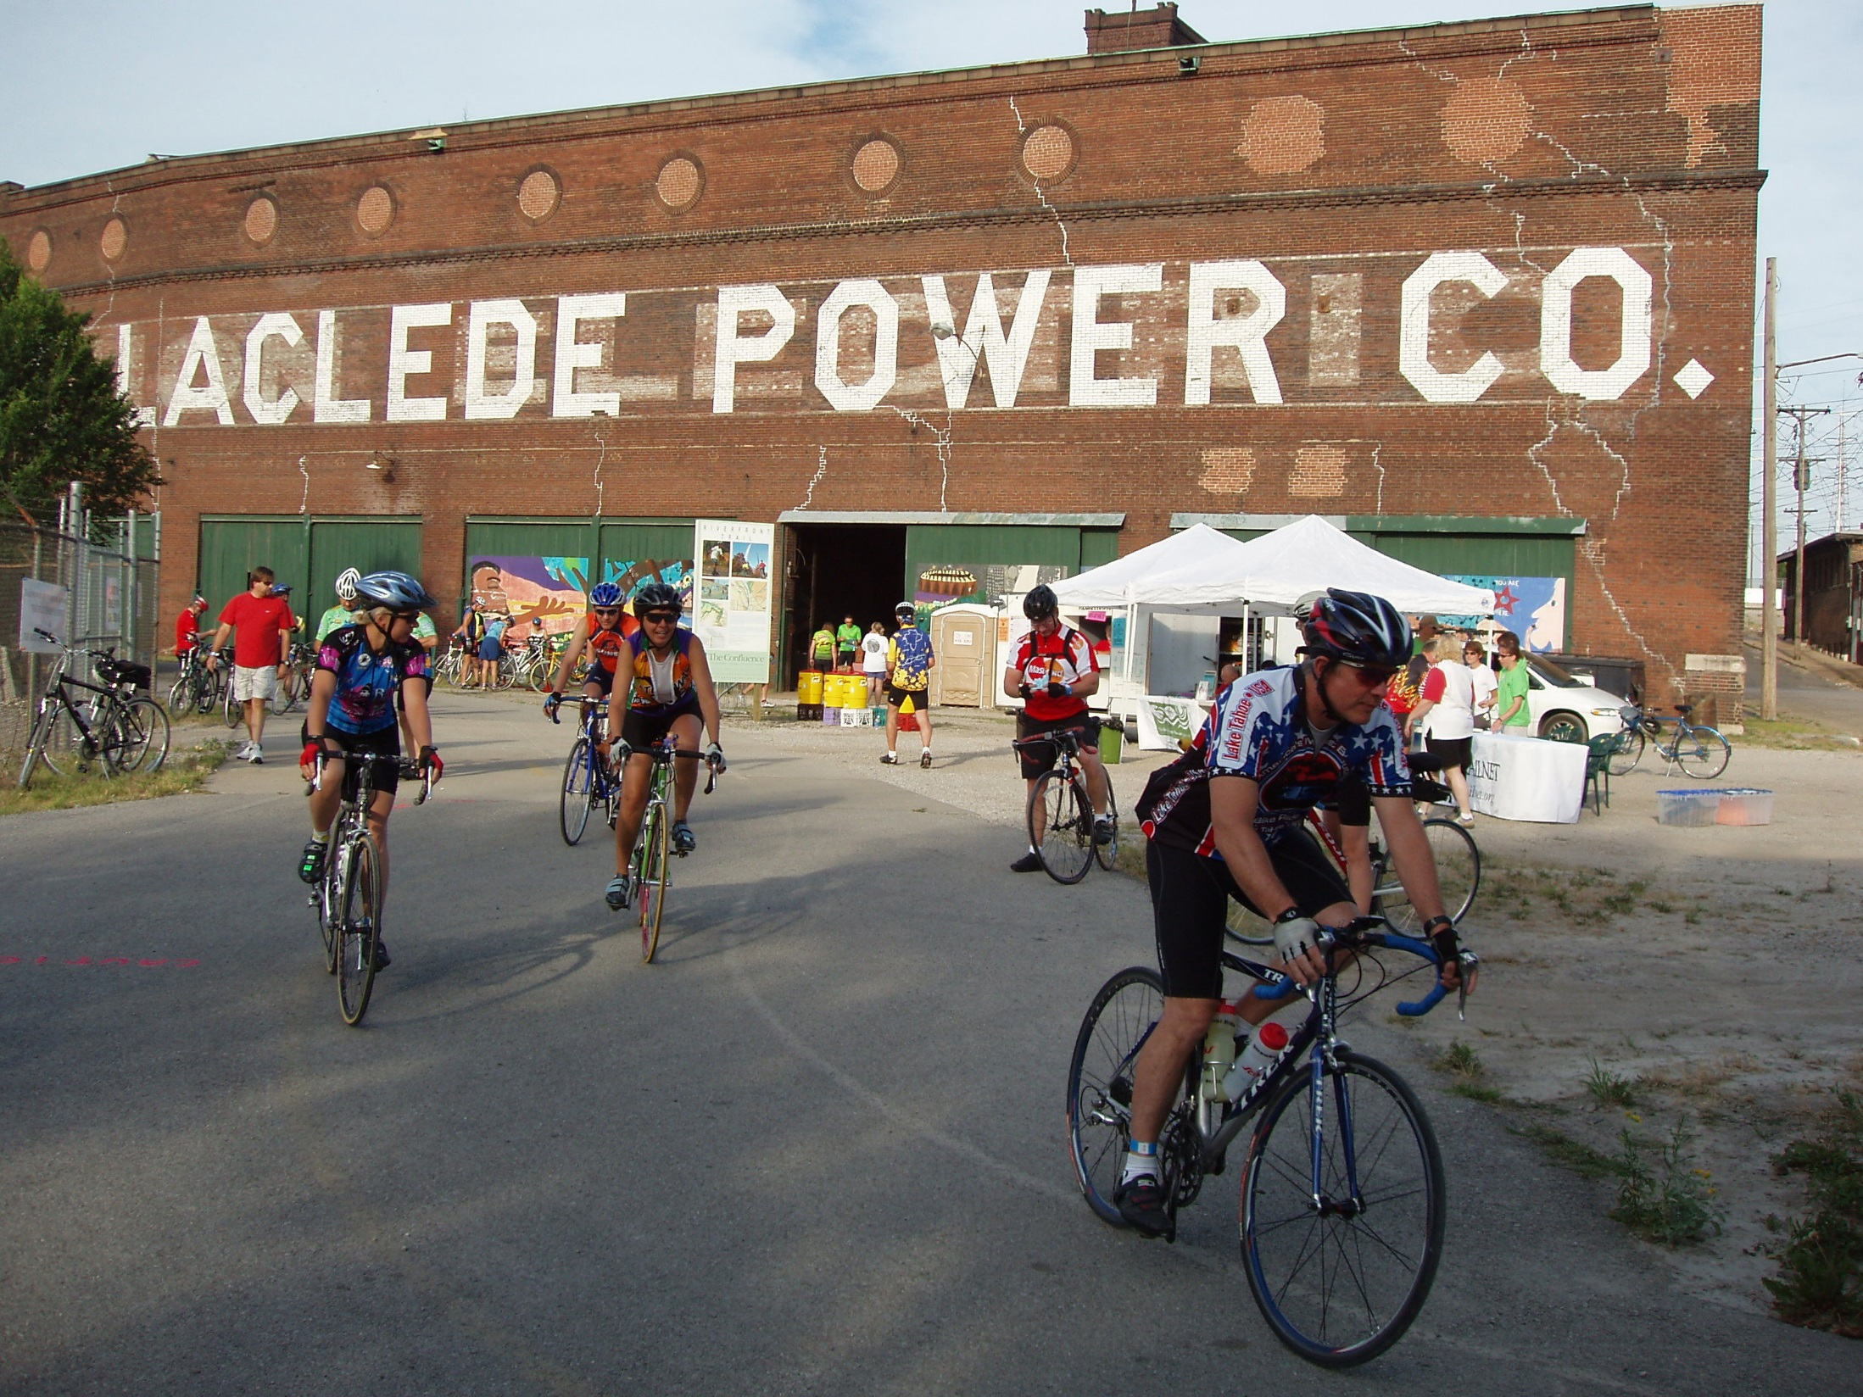
Gateway Bike Plan Goals
Goal 1: Provide a prioritized system of routes that are contiguous and connected to other on- and off-road facilities.
Goal 2: Improve safety for all modes of transportation through the careful design and implementation of bicycle facilities.
Goal 3: Improve safety for all modes of transportation through the implementation of educational and enforcement programs.
Goal 4: Expand the public’s view that bicycles are a viable/acceptable mode of transportation through encouragement programs.
Goal 5: Increase the commitment of public officials to support or initiate public policy for bicycling in all levels of government—state, local, and regional.

Slide 7







Who is working to implement the Plan?
Other partners include:
local municipalities
advocacy organizations
bike shops
area residents

Slide 8
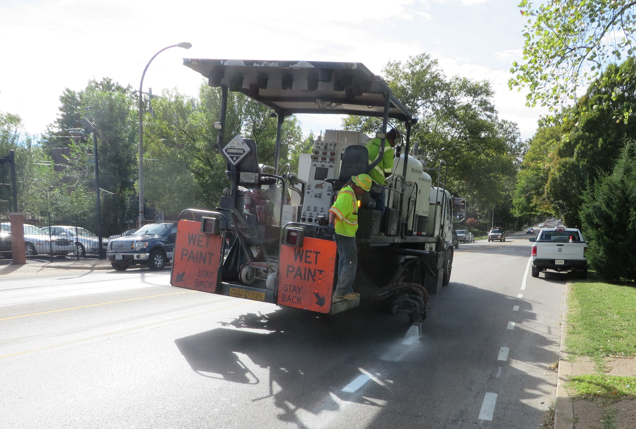
What’s been accomplished so far?
140 miles of on-street bikeways constructed since the plan’s adoption (266 miles total!)
New Bike St Louis and Regional Bikeways maps
Creation of a regional committee to oversee plan implementation
An average of 40 events a year to encourage people to get out and bike
An average of 22 bike education classes per year
An average of 18 training courses for engineers, planners, and city officials to help create bike-friendly communities

Slide 9
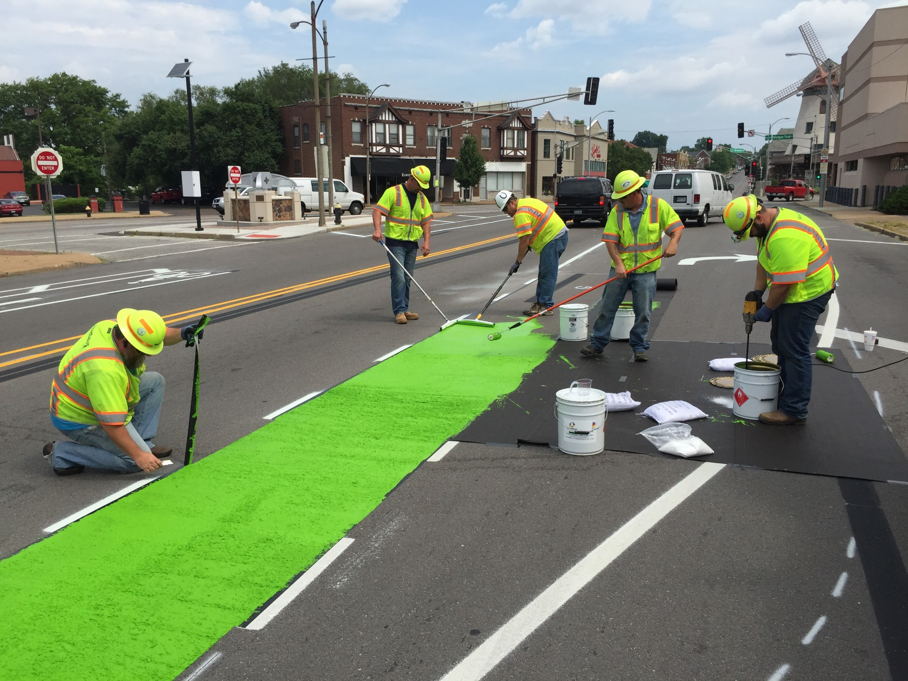
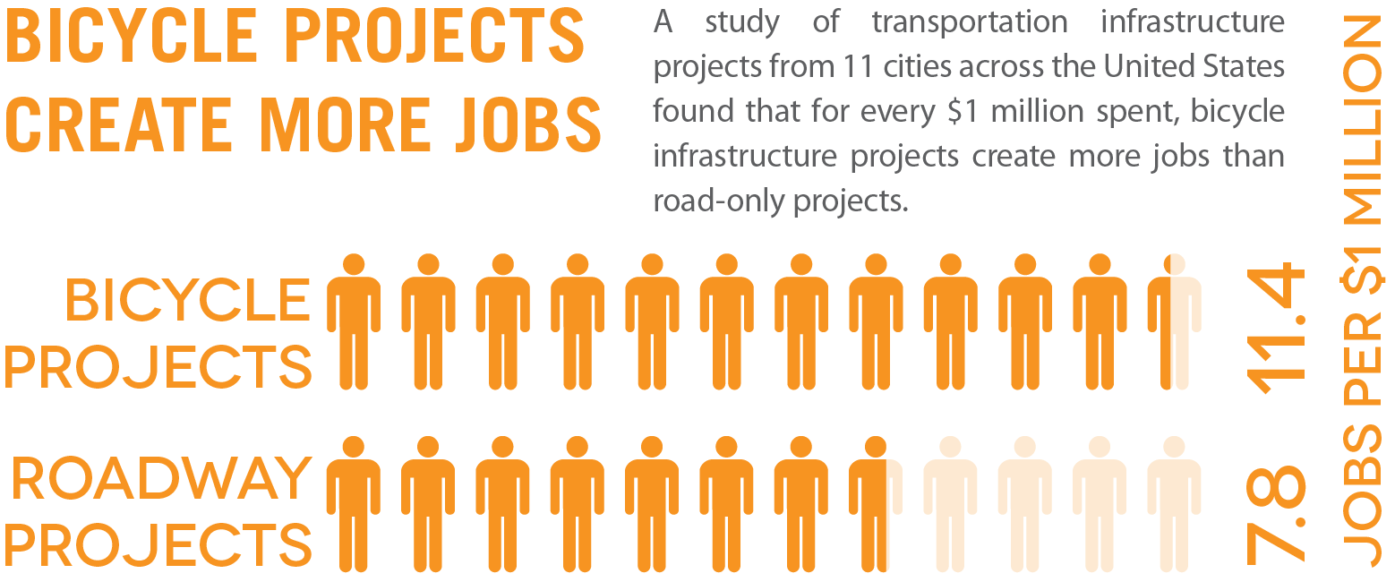
Benefits of a Bikeable Community

Slide 10
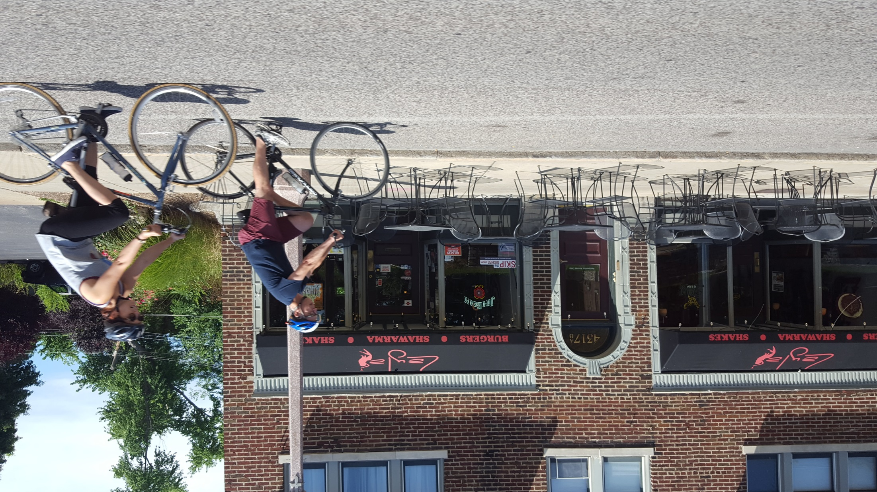
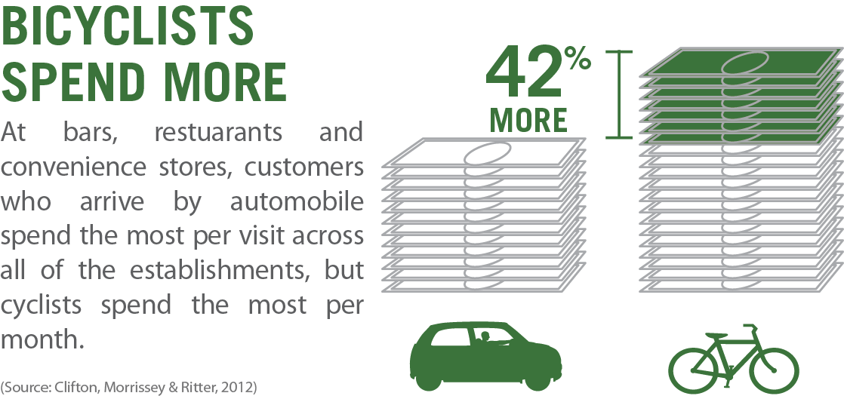
Benefits of a Bikeable Community

Slide 11
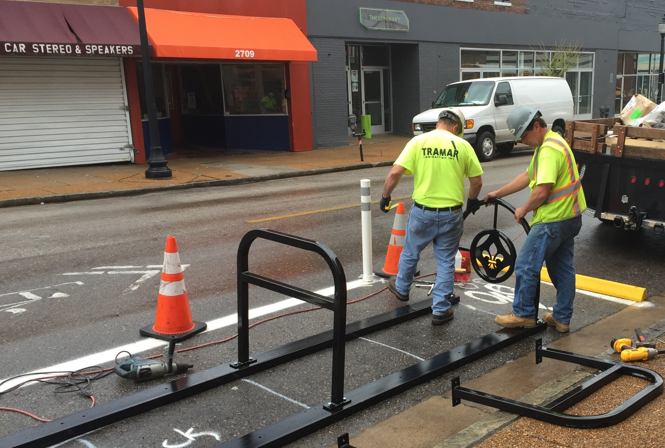
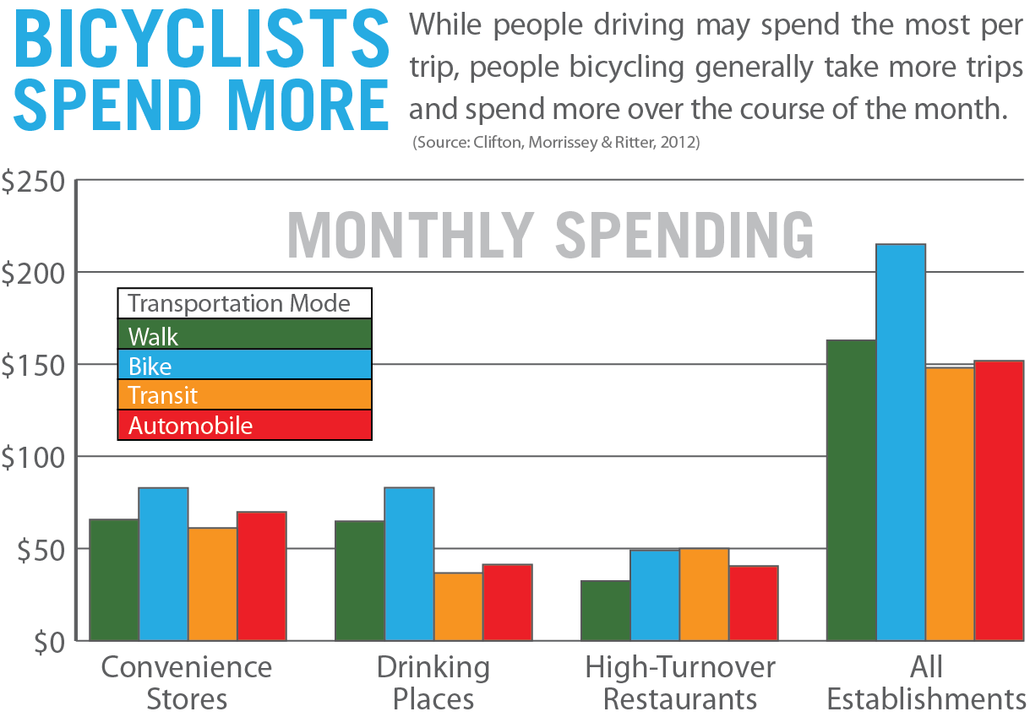
Benefits of a Bikeable Community

Slide 12
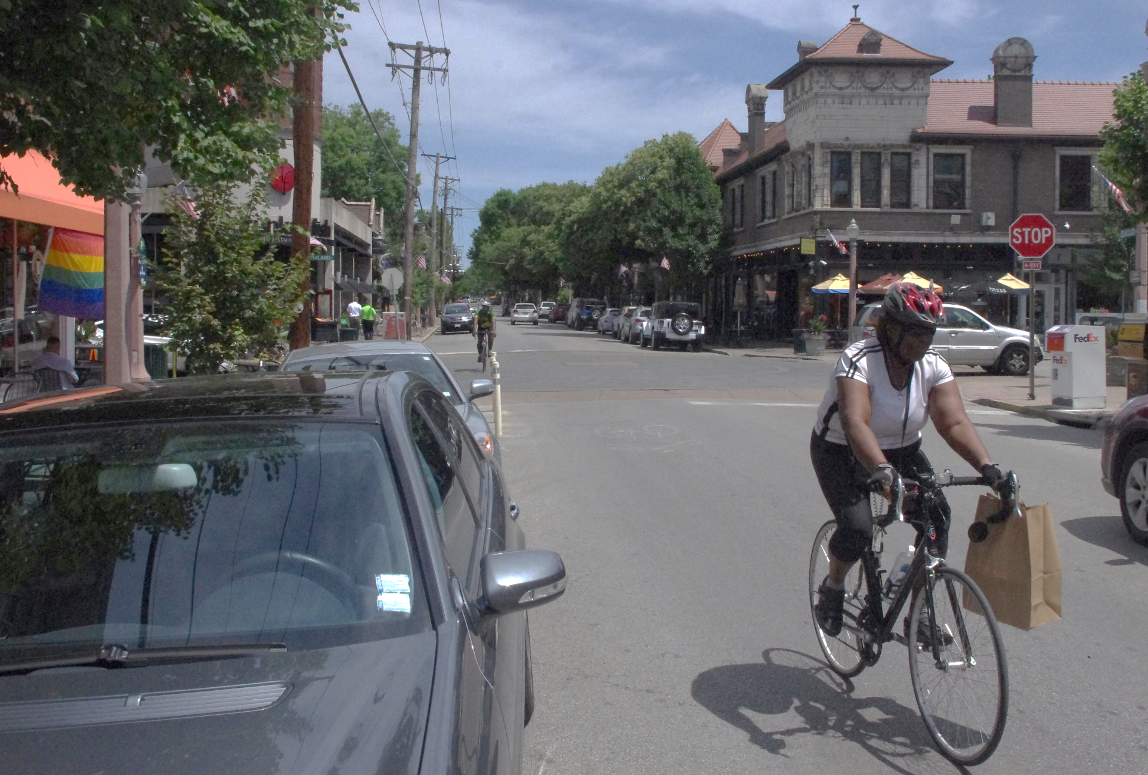
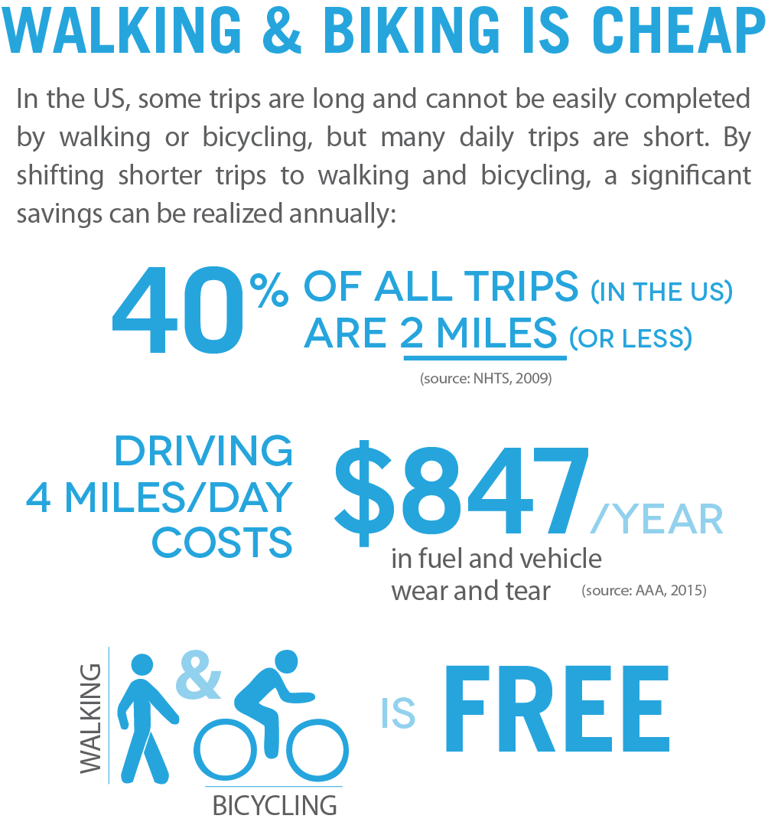
Benefits of a Bikeable Community

Slide 13
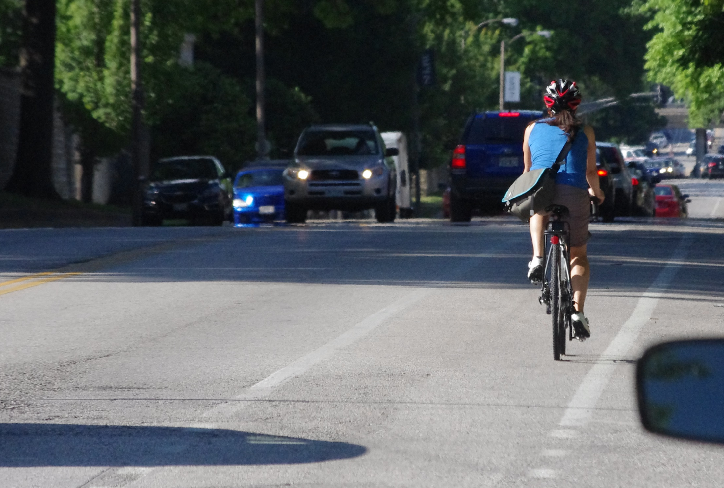
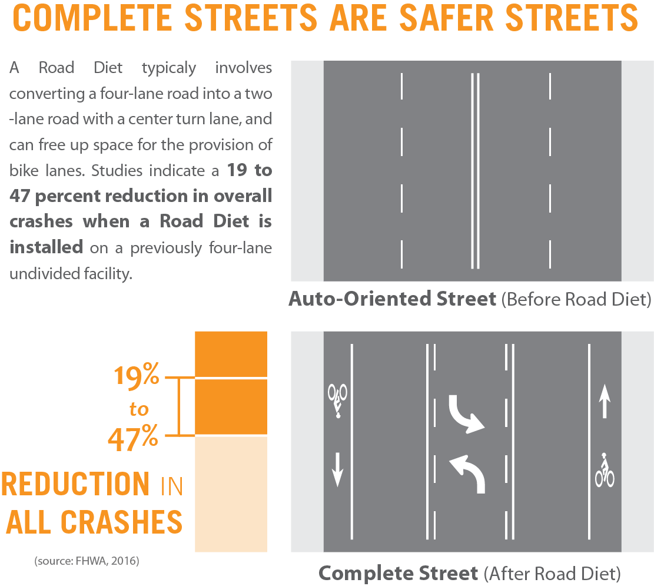
Benefits of a Bikeable Community

Slide 14
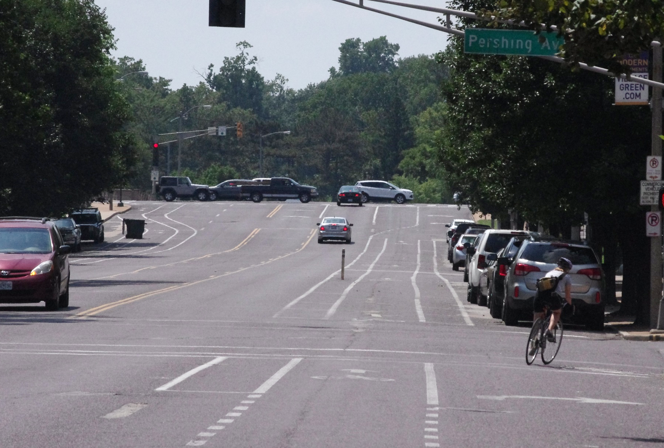
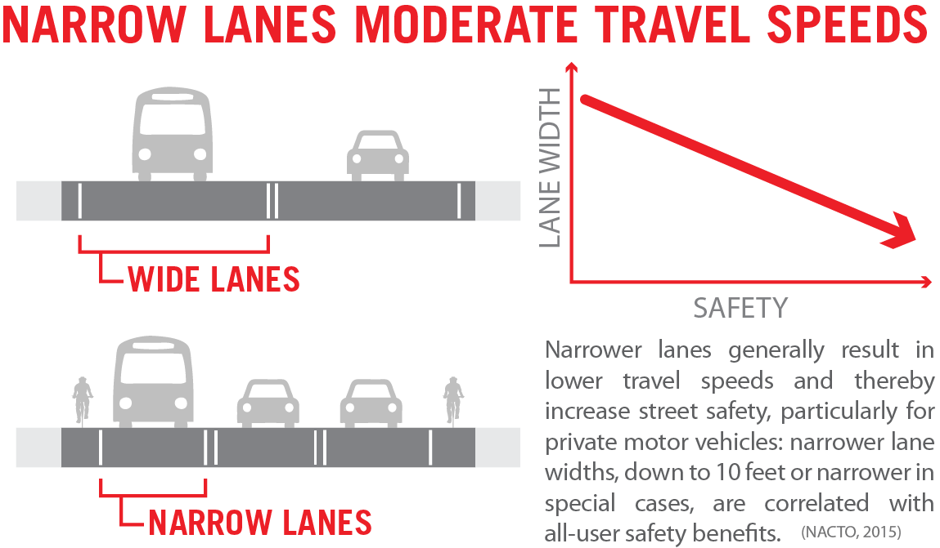
Benefits of a Bikeable Community

Slide 15
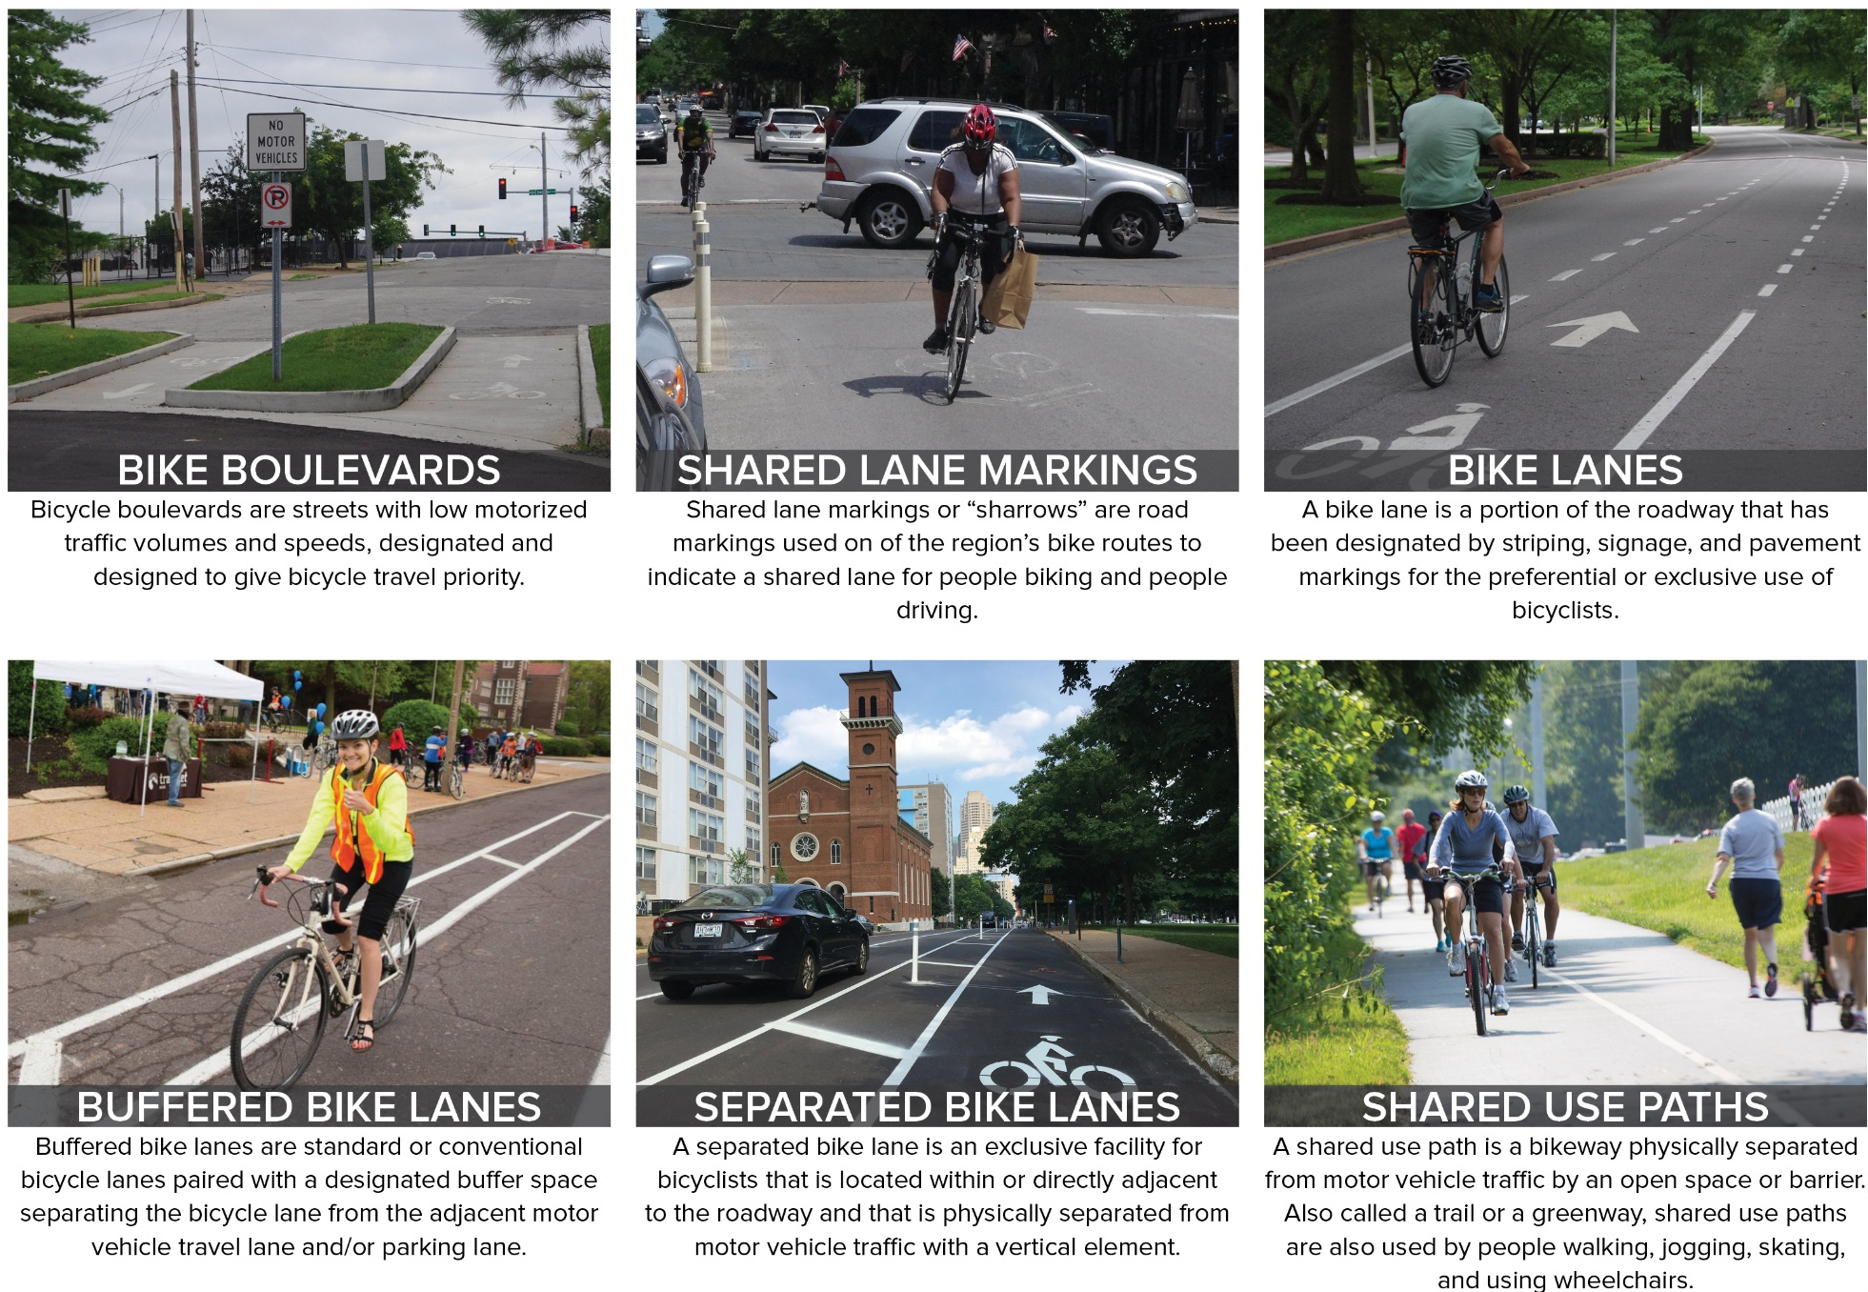
Basic Bicycle Facility Types

Slide 16
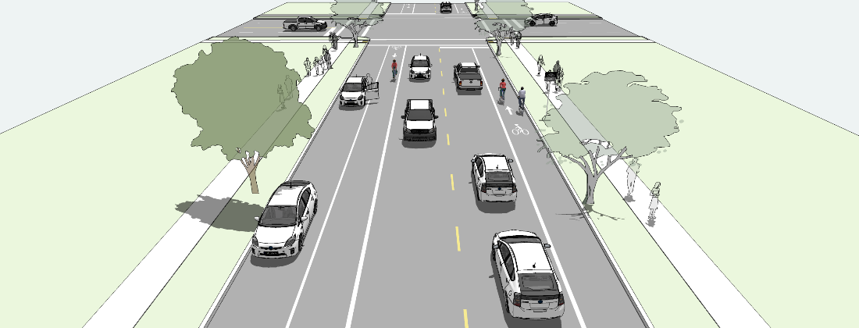
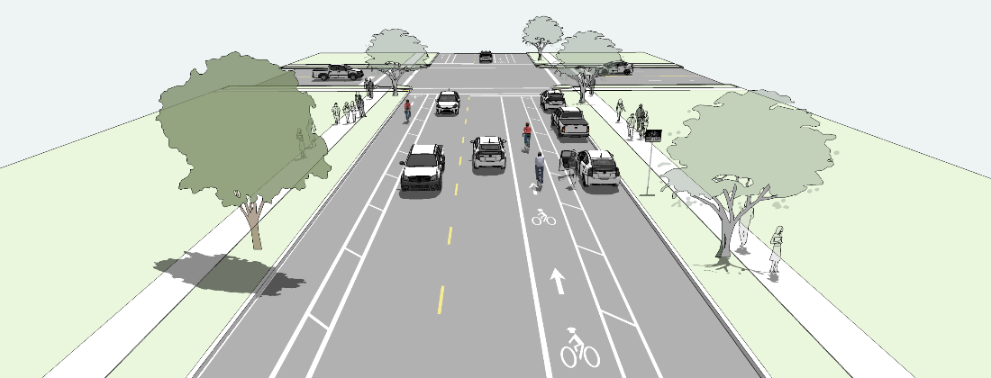
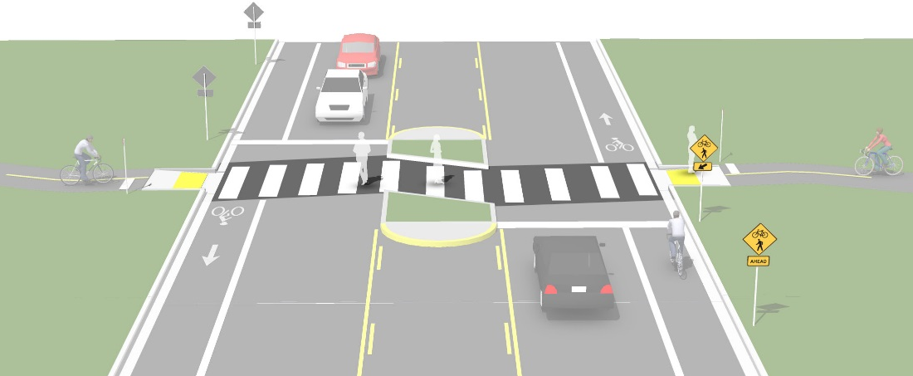
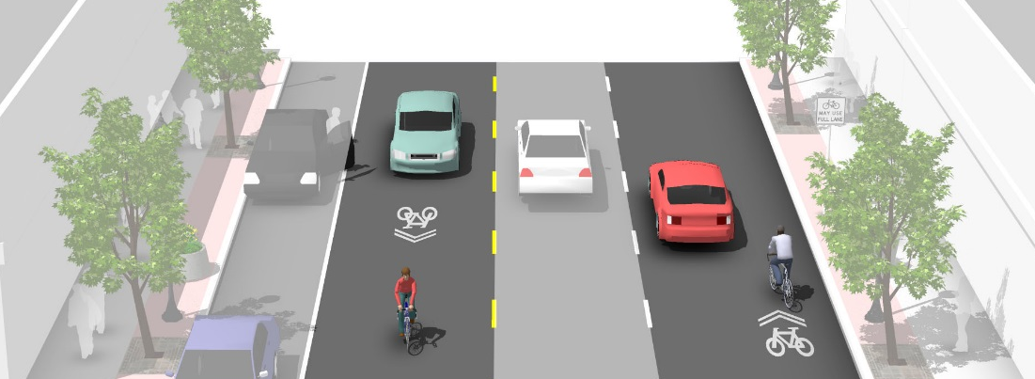
Most Common Bicycle Facility Types
These four facility types are present throughout the region and comprise the majority of the region’s bikeway network. The following slides provide additional information about these bikeways.
Bike Lane
Buffered Bike Lane
Shared Lane Markings
Trails & Greenways
(at roadway crossings)

Slide 17
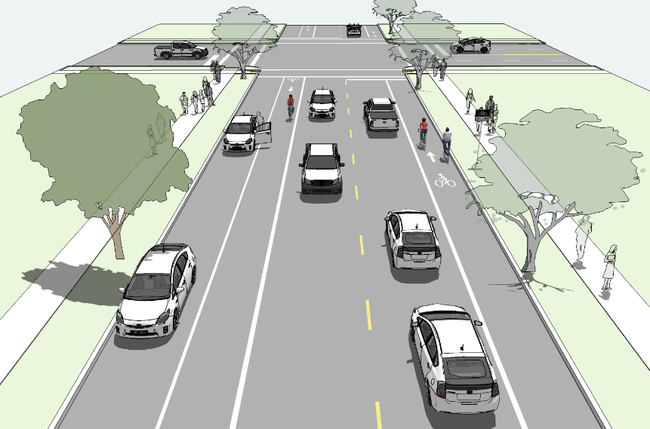
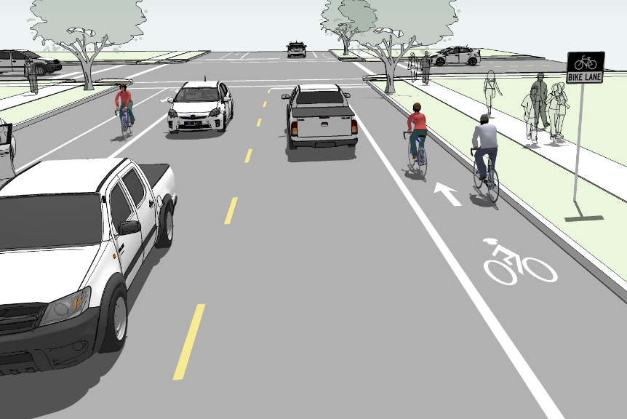
Bike Lane
Bike lanes provide a designated space for people to travel by bicycle on area streets. Bike lanes are marked by white paint and signage, and flow in the same direction as traffic.
Bike lanes:
Increase the comfort level of people bicycling on busy streets.
Provide a designated space on the roadway for people bicycling next to travel lanes.
Encourage predictability of bicyclist and motorist positioning and interactions.
Increase the capacity of streets by carrying a mix of bicycle and motor vehicle traffic while maintaining posted speed limits.
Remove slower-moving bikes from motor vehicle travel lanes, reducing delay for drivers.

Slide 18
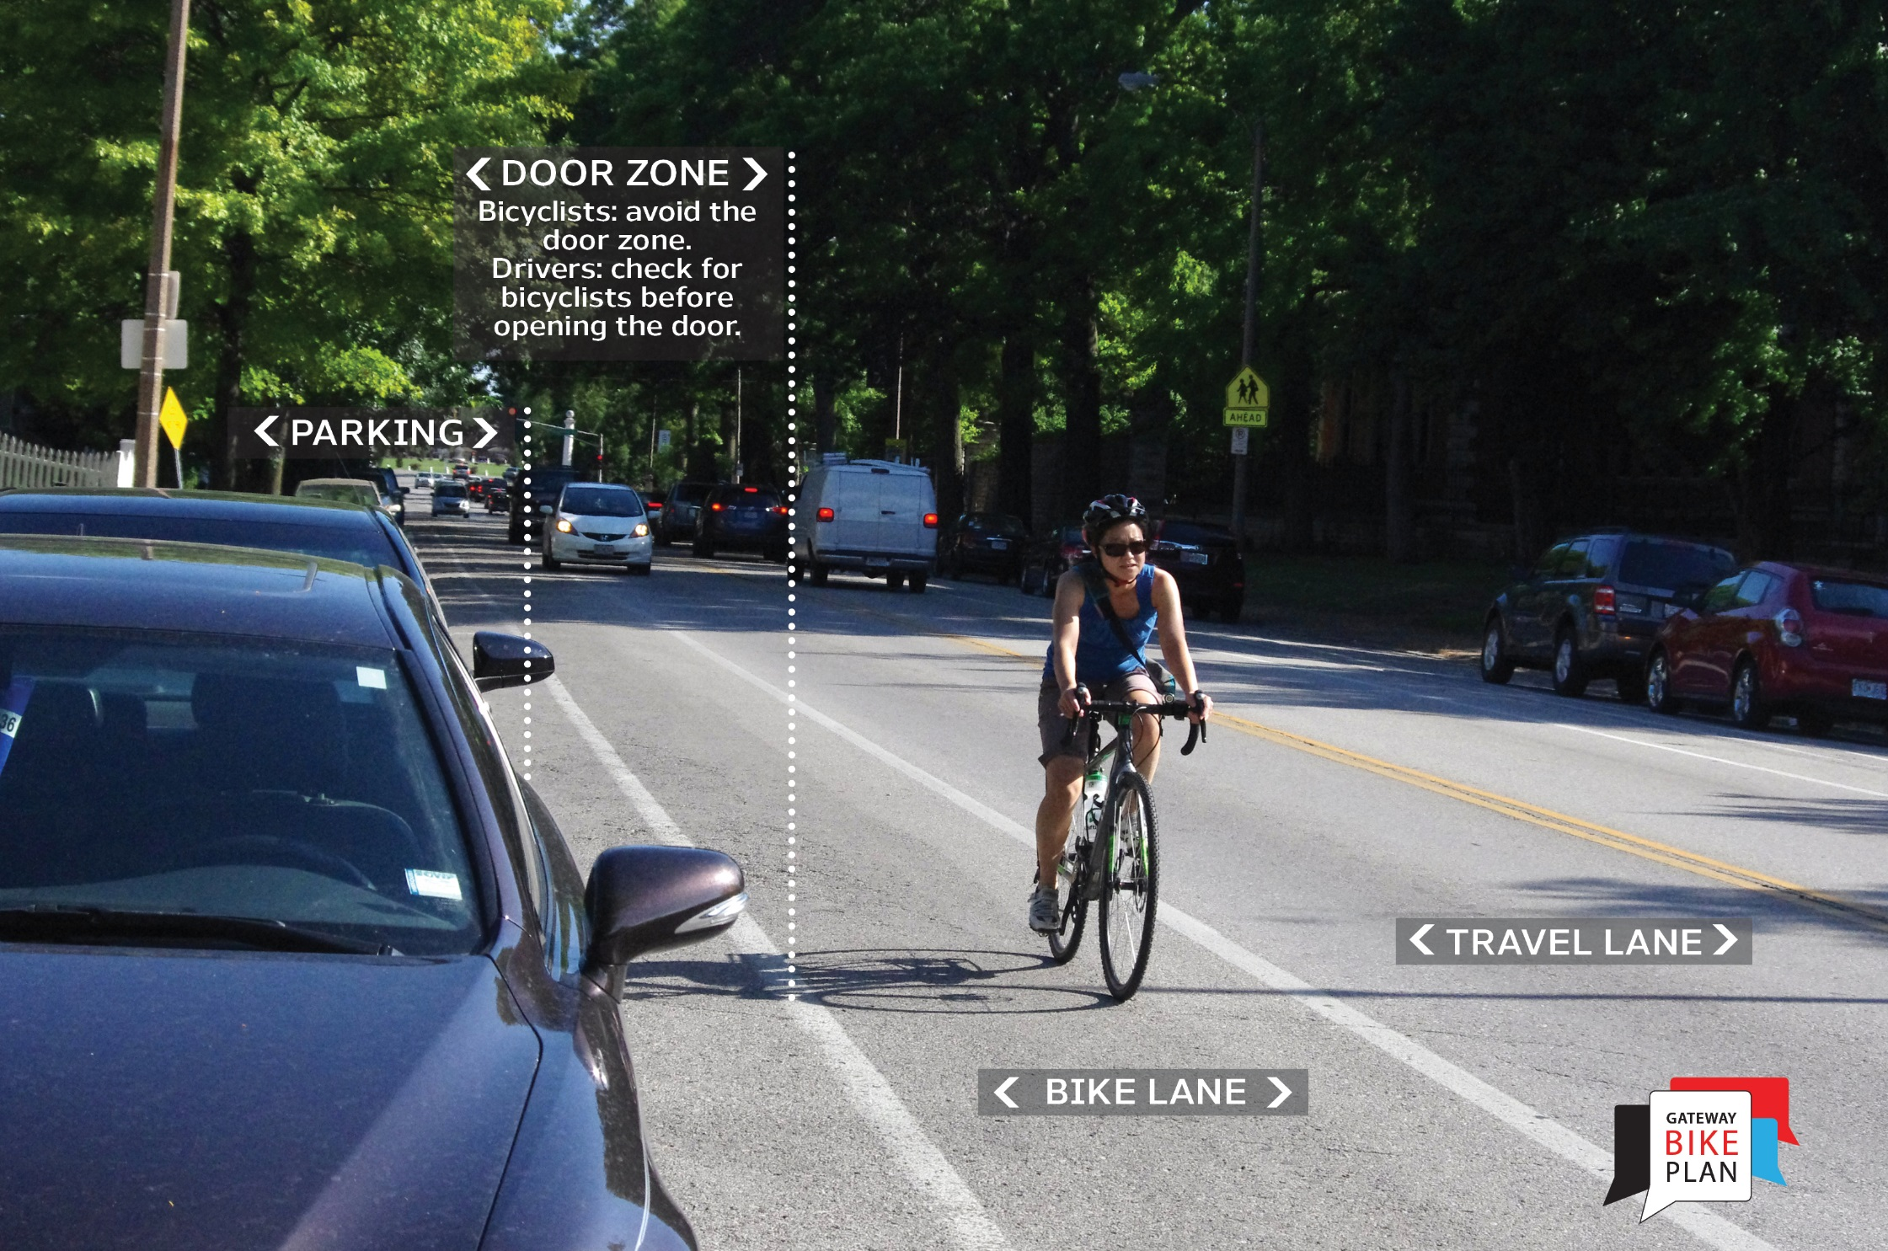
Bike Lane

Slide 19

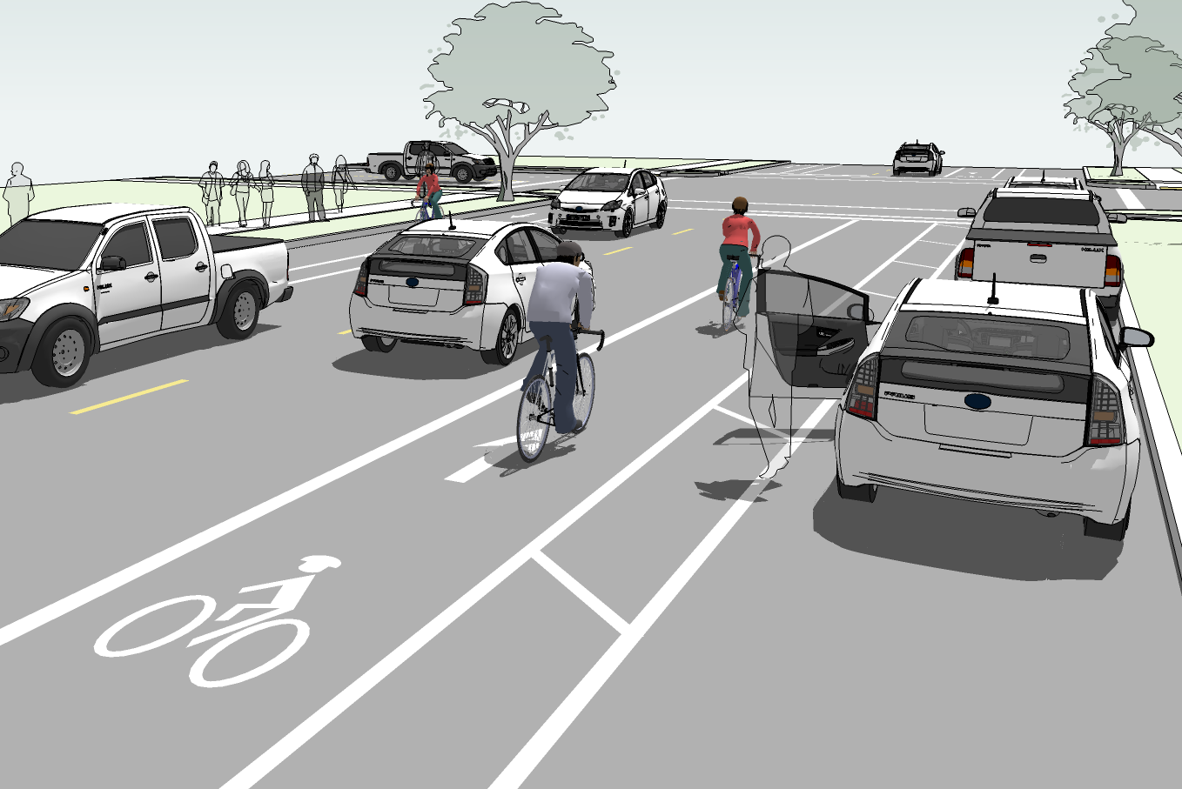
Buffered Bike Lane
Buffered bike lanes are like regular bike lanes, but they have a designated buffer space separating the bicycle lane from the adjacent motor vehicle travel lane, the parking lane, or both.
Buffered bike lanes:
Provide a greater distance between motor vehicles and people biking.
Increase the distance between people biking and parked cars keeping bicyclists out of the “door zone.”
Encourage bicycling by all types of people and increase the safety of all road users.
Provide space for people biking to pass each other without encroaching into travel lanes.

Slide 20
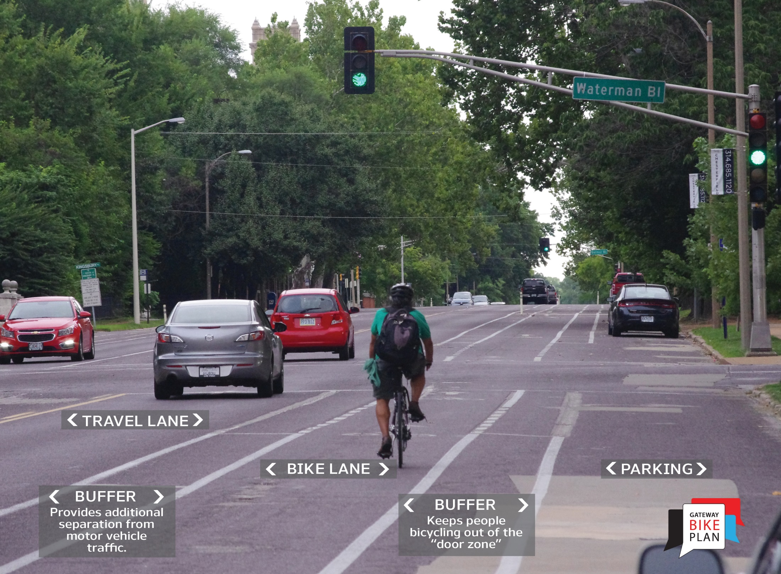
Buffered Bike Lane

Slide 21

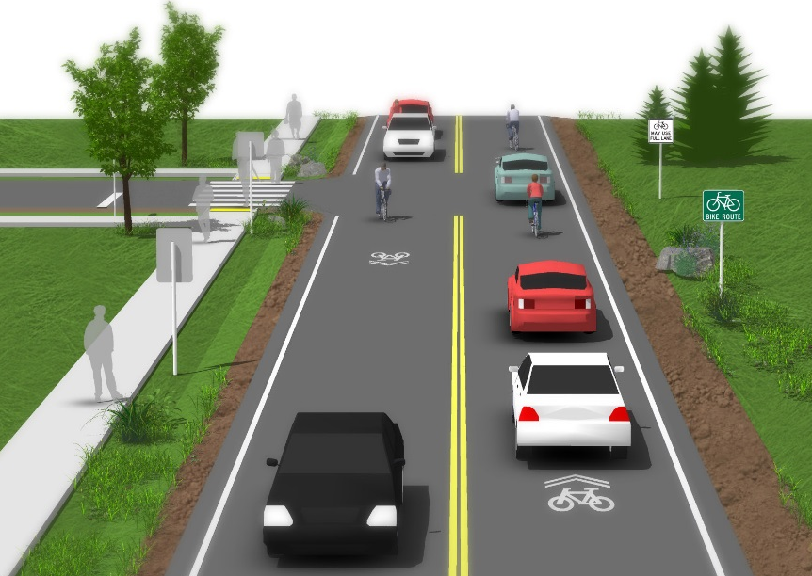
Shared Lane Markings
Shared lane markings or “sharrows” are road markings used to indicate a shared lane for people biking and motor vehicles. These markings combine a bicycle stencil below two chevrons or arrows and are seen on local bicycle routes throughout the region.
Shared lane markings:
Encourage people bicycling to position themselves safely in lanes too narrow for a motor vehicle and bicycle to travel side by side.
Alert motor vehicle drivers to the presence of people bicycling.
Provide a wayfinding element along bike routes to insure users are connecting to other bicycle facilities.
Encourage safe passing by motorists.

Slide 22
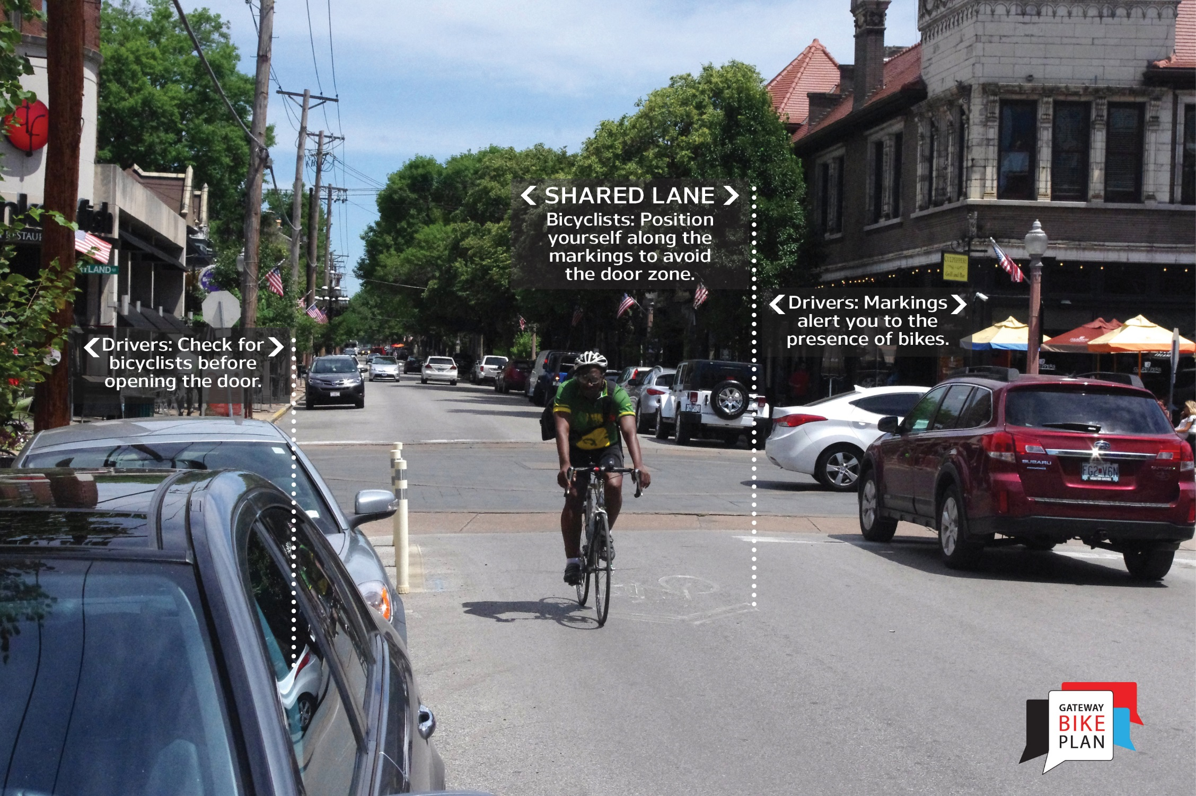
Shared Lane Markings

Slide 23
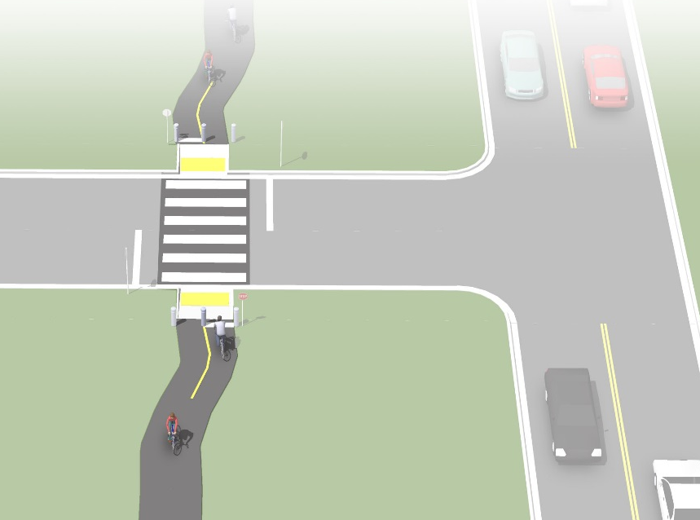
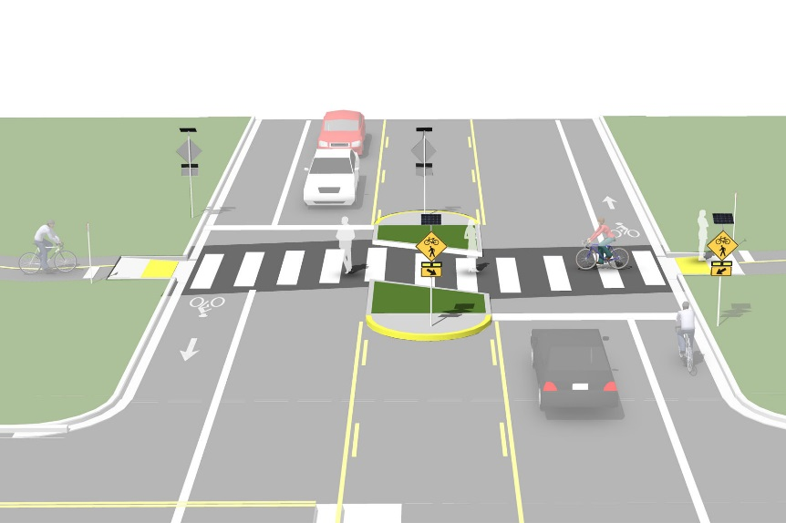
Trail Crossings at Roadways
Raise awareness for people bicycling, people walking, and people driving to potential conflict areas.
Guide trail users through an intersection with a roadway or other trail.
Make movements of trail users more predictable by delineating where people bicycling should cross.
Increase the visibility of people bicycling and walking.

Slide 24
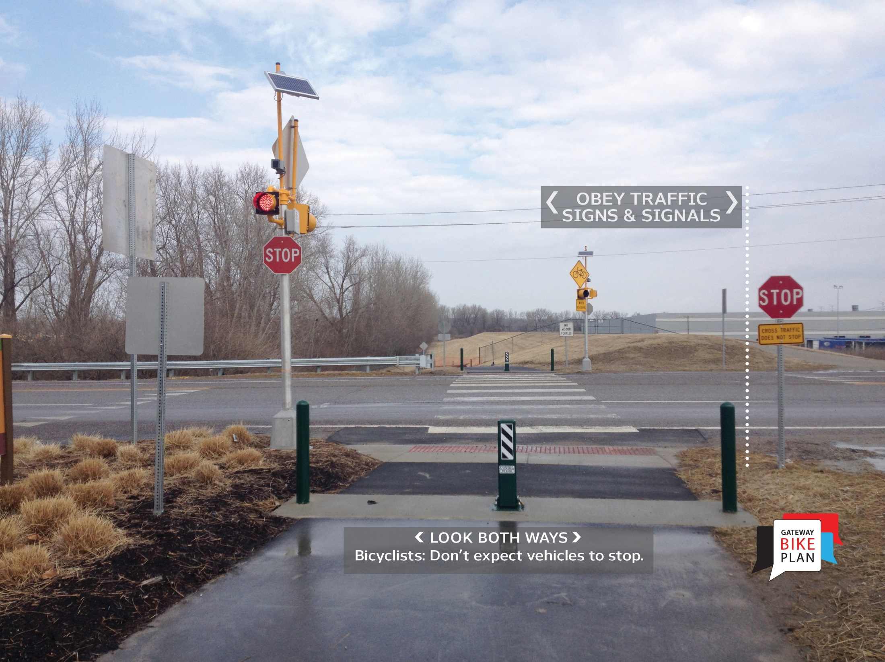
Trail Crossings at Roadways

